Slide 1
CH27 Trusted Computing and MILS
Zonghua Gu
2017, ZJU
Notes:
This chapter provides an overview of computer security. We begin with a discussion
of what we mean by computer security. In essence, computer security deals
with computer-related assets that are subject to a variety of threats and for which
various measures are taken to protect those assets. Accordingly, the next section of
this chapter provides a brief overview of the categories of computer-related assets
that users and system managers wish to preserve and protect, and a look at the
various threats and attacks that can be made on those assets. Then, we survey the
measures that can be taken to deal with such threats and attacks. This we do from
three different viewpoints, in Sections 1.3 through 1.5. We then lay out in general
terms a computer security strategy.
The focus of this chapter, and indeed this book, is on three fundamental
questions:
1. What assets do we need to protect?
2. How are those assets threatened?
3. What can we do to counter those threats?

Slide 2
Outline
Bell-LaPadula (BLP), Biba and Chinese wall model
Reference monitors for trusted systems
Application of multilevel security to databases
TCB and TPM
Common Criteria

Slide 3
Multilevel Security (MLS)
RFC 4949 defines multilevel security as follows:
“A mode of system operation wherein (a) two or more security levels of information are allowed to be handled concurrently within the same system when some users having access to the system have neither a security clearance nor need-to-know for some of the data handled by the system and (b) separation of the users and the classified material on the basis, respectively, of clearance and classification level are dependent on operating system control.”
Notes:
Multilevel security is of interest when there is a requirement to maintain
a resource, such as a file system or database in which multiple levels of data
sensitivity are defined. The hierarchy could be as simple as two levels (e.g., public
and proprietary) or could have many levels (e.g., the military unclassified,
restricted, confidential, secret, top secret). The preceding three sections have
introduced us to the essential elements of multilevel security. In this section, we
look at two applications areas where MLS concepts have been applied: role-based
access control system and database security.

Slide 4
BLP and Biba Models
Security levels
  A subject has a security clearance; an object has a security classification
  Both are security levels forming a total order: top secret > secret > confidential > restricted > unclassified
Bell-LaPadula (BLP) model: designed for protecting confidentiality of high-level objects from low-level subjects
  Information flow from high to low-level is disallowed.
Biba model: designed for protecting integrity of high-level objects from low-level subjects
  Information flow from low to high-level is disallowed.
BLP and Biba are examples of Mandatory Access Control (MAC).

Slide 5
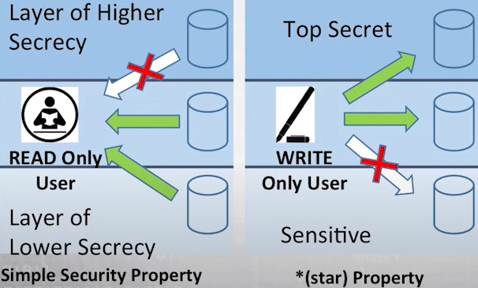
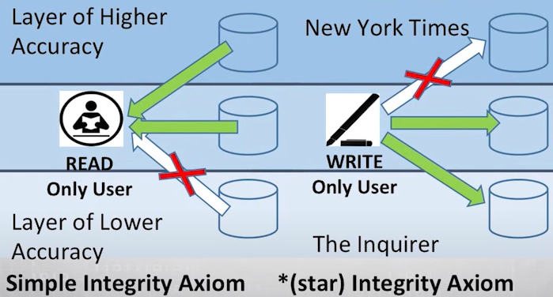
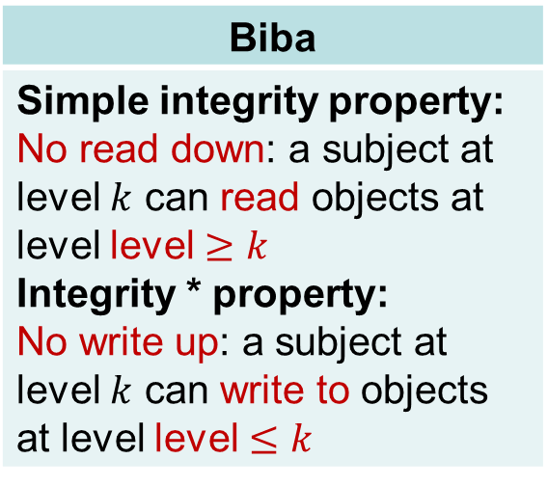
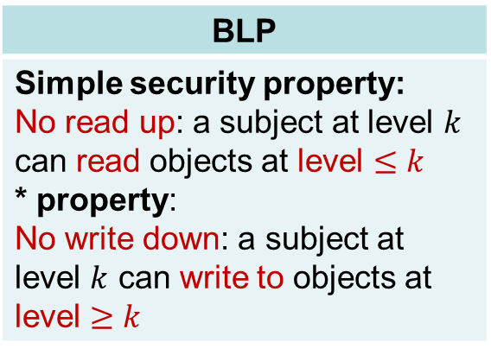
BLP
Simple security property: No read up: a subject at level $k$ can read objects at level $≤k$ * property: No write down: a subject at level $k$ can write to objects at level $≥k$
Biba
Simple integrity property: No read down: a subject at level $k$ can read objects at level level $≥k$ Integrity * property: No write up: a subject at level $k$ can write to objects at level level $≤k$
Arrows indicate information flow direction.
Notes:
https://www.youtube.com/watch?v=SfryxGRXoVg
A soldier should not be able to read a general’s files.
New York Times (a respectable newspaper) content should not be polluted by a tabloid (the Inquirer), i.e., a writer for a tabloid (the Inquirer) should not write articles for the New York Times.

Slide 6
BLP Quiz
True or False: under BLP, an unclassified document can be read or written by anyone.
ANS: False
  Since “unclassified” is the lowest security level, any subject can read it (no read up), but only subjects at the unclassified level can write to it (no write down)
True or False: under BLP, an unclassified user can create a classified document
ANS: True (no write down)

Slide 7
BLP *-property
If no *-property, the following may occur:
A malicious subject passes classified information along by putting it into an object labeled at a lower security classification than the information itself. This will allow a subsequent read access to this object by a subject at the lower clearance level.
Notes:
Figure 13.1 illustrates the need for the *-property. Here, a malicious subject
passes classified information along by putting it into an information container
labeled at a lower security classification than the information itself. This will allow a
subsequent read access to this information by a subject at the lower clearance level.
These two properties provide the confidentiality form of what is known as
mandatory access control (MAC). Under this MAC, no access is allowed that does
not satisfy these two properties. In addition, the BLP model makes a provision for
discretionary access control (DAC).
• ds-property : An individual (or role) may grant to another individual (or role)
access to a document based on the owner’s discretion, constrained by the MAC
rules. Thus, a subject can exercise only accesses for which it has the necessary
authorization and which satisfy the MAC rules.
The basic idea is that site policy overrides any discretionary access controls.
That is, a user cannot give away data to unauthorized persons.

Slide 8
BLP Model Example
Assuming a Role-Based Access Control system. Carla is a student (s) in course c1. Dirk is a teacher (t) in course c1 but may also access the system as a student; thus two roles are assigned to Dirk:
  Carla: (c1-s)
  Dirk: (c1-t), (c1-s)
The student role is assigned a lower, and the teacher role a higher security clearance level

Slide 9
Figure 13.2a: Dirk creates a new file f1 as c1-t; Carla creates file f2 as c1-s (). Carla can read and write to f2, but cannot read f1, because it is at a higher classification level (teacher level). In the c1-t role, Dirk can read and write f1 and can read f2 if Carla grants access to f2. However, in this role, Dirk cannot write f2 because of the *-property; neither Dirk nor a Trojan horse on his behalf can downgrade data from the teacher level to the student level. Only if Dirk logs in as a student can he create a c1-s file or write to an existing c1-s file, such as f2. In the student role, Dirk can also read f2.
Figure 13.2b: Dirk reads f2 and wants to create a new file with comments to Carla as feedback. Dirk must sign in student role c1-s to create f3 so that it can be accessed by Carla. In a teacher role, Dirk cannot create a file at a student classification level.
Notes:
This example illustrates the operation of the BLP model and also highlights a practical
issue that must be addressed. We assume a role-based access control system.
Carla and Dirk are users of the system. Carla is a student (s) in course c1. Dirk is a
teacher (t) in course c1 but may also access the system as a student;
thus two roles are assigned to Dirk:
Carla: (c1-s)
Dirk: (c1-t), (c1-s)
The student role is assigned a lower security clearance and the teacher role a
higher security clearance. Let us look at some possible actions:
1. Dirk creates a new file f1 as c1-t; Carla creates file f2 as c1-s ( Figure 13.2a ).
Carla can read and write to f2, but cannot read f1, because it is at a higher
classification level (teacher level). In the c1-t role, Dirk can read and write f1
and can read f2 if Carla grants access to f2. However, in this role, Dirk cannot
write f2 because of the *-property; neither Dirk nor a Trojan horse on his
behalf can downgrade data from the teacher level to the student level. Only if
Dirk logs in as a student can he create a c1-s file or write to an existing c1-s file,
such as f2. In the student role, Dirk can also read f2.
2. Dirk reads f2 and wants to create a new file with comments to Carla as feedback.
Dirk must sign in student role c1-s to create f3 so that it can be accessed
by Carla ( Figure 13.2b ). In a teacher role, Dirk cannot create a file at a student
classification level.

Slide 10
Figure 13.2c: Dirk creates an exam based on an existing exam template file at level c1-t. Dirk must log in as c1-t to read the template and the file he creates (f4) must also be at the teacher level.
Figure 13.2d: Dirk wants Carla to take the exam and so must provide her with read access. However, such access would violate the ss-property. Dirk must downgrade the classification of f4 from c1-t to c1-s. Dirk cannot do this in the c1-t role because this would violate the *-property. Therefore, a security administrator must have downgrade authority and must be able to perform the downgrade outside the BLP model. The dotted line connecting f4 with c1-s-read indicates that this connection has not been generated by the default BLP rules but by a system operation.
Notes:
Dirk creates an exam based on an existing template file store at level c1-t.
Dirk must log in as c1-t to read the template and the file he creates (f4) must
also be at the teacher level ( Figure 13.2c ).
4. Dirk wants Carla to take the exam and so must provide her with read access.
However, such access would violate the ss-property. Dirk must downgrade
the classification of f4 from c1-t to c1-s. Dirk cannot do this in the c1-t role
because this would violate the *-property. Therefore, a security administrator
(possibly Dirk in this role) must have downgrade authority and must beable to perform the downgrade outside the BLP model. The dotted line in
Figure 13.2d connecting f4 with c1-s-read indicates that this connection has
not been generated by the default BLP rules but by a system operation.

Slide 11
BLP Model Example cont’d
Carla writes the answers to the exam into a file f5. She creates the file at level c1-t so that only Dirk can read the file. Carla can still see her answers at her workstation but cannot access f5 for reading.
Notes:
5. Carla writes the answers to the exam into a file f5. She creates the file at
level c1-t so that only Dirk can read the file. This is an example of writing up,
which is not forbidden by the BLP rules. Carla can still see her answers at her
workstation but cannot access f5 for reading.
This discussion illustrates some critical practical limitations of the BLP
model. First, as noted in step 4, the BLP model has no provision to manage the
“downgrade” of objects, even though the requirements for multilevel security
recognize that such a flow of information from a higher to a lower level may be
required, provided it reflects the will of an authorized user. Hence, any practical
implementation of a multilevel system has to support such a process in a controlled
and monitored manner. Related to this is another concern. A subject constrained
by the BLP model can only be “editing” (reading and writing) a file at one security
level while also viewing files at the same or lower levels. If the new document
consolidates information from a range of sources and levels, some of that information
is now classified at a higher level than it was originally. This is known as classification
creep and is a well-known concern when managing multilevel information.
Again, some process of managed downgrading of information is needed to restore
reasonable classification levels.

Slide 12
Chinese Wall (CW) Model
Designed to prevent Conflict-of-Interest (CI). Elements include:
  Dataset (DS): All objects that concern the same company
  Conflict-of-interest (CI) class: All datasets whose companies are in competition
A subject can access any object as long as it has not accessed an object from another company in the same CI class
Once a subject accesses information from one dataset, a wall is set up to protect information in other datasets in the same CI class.
CW model does not protect confidentiality (like BLP) or integrity (like Biba).
Notes:
The Chinese Wall Model (CWM) takes a quite different approach to specifying
integrity and confidentiality than any of the approaches we have examined so far.
The model was developed for commercial applications in which conflicts of interest
can arise. The model makes use of both discretionary and mandatory access concepts.
The principal idea behind the CWM is a concept that is common in the financial
and legal professions, which is to use a what is referred to as a Chinese wall to prevent
a conflict of interest. An example from the financial world is that of a market analyst
working for a financial institution providing corporate business services. An analyst
cannot be allowed to provide advice to one company when the analyst has confidential
information (insider knowledge) about the plans or status of a competitor. However,
the analyst is free to advise multiple corporations that are not in competition with
each other and to draw on market information that is open to the public.
The elements of the model are the following:
• Subjects: Active entities that may wish to access protected objects; includes
users and processes
• Information: Corporate information organized into a hierarchy with three levels:
— Objects: Individual items of information, each concerning a single
corporation
— Dataset (DS): All objects that concern the same corporation
— Conflict of interest (CI) class: All datasets whose corporations are in
competition
• Access rules: Rules for read and write access

Slide 13
CW Simple Security Rule
CW Simple Security rule: A subject S can read object O only if
  O is in the same DS as an object already accessed by S, OR
  O belongs to a CI class from which S has not yet accessed any information
Figures 13.6b and c: Assume that at some point, John has made his first read request to any object in this set for an object in the Bank A DS. Because John has not previously accessed an object in any other DS in CI 1, the access is granted. Any subsequent request for access to an object in the Bank B DS will be denied. Any request for access to other objects in the Bank A DS is granted.
At a later time, John requests access to an object in the Oil A DS. Because there is no conflict, this access is granted, but a wall is set up prohibiting subsequent access to the Oil B DS.
Similarly, Figure 13.6c reflects the access history of Jane.
(Bank A DS should contain a,b,c here. In next slide, John changes a to g in violation of *-property.)
a
a
Notes:
Figure 13.6a gives an example. There are datasets representing banks, oil
companies, and gas companies. All bank datasets are in one CI, all oil company
datasets in another CI, and so forth.
In contrast to the models we have studies so far, the CWM does not assign security
levels to subjects and objects and is thus not a true multilevel secure model. Instead, the
history of a subject’s previous access determines access control. The basis of the Chinese
wall policy is that subjects are only allowed access to information that is not held to conflict
with any other information that they already possess. Once a subject accesses information
from one dataset, a wall is set up to protect information in other datasets in the same CI.
The subject can access information on one side of the wall but not the other side. Further,
information in other CIs is initially not considered to be on one side or the other of the
wall but out in the open. When additional accesses are made in other CIs by the same
subject, the shape of the wall changes to maintain the desired protection. Further, each
subject is controlled by his or her own wall—the walls for different subjects are different.
To enforce the Chinese wall policy, two rules are needed. To indicate the similarity
with the two BLP rules, the authors gave them the same names. The first rule
is the simple security rule:
Simple security rule: A subject S can read on object O only if
• O is in the same DS as an object already accessed by S, OR
• O belongs to a CI from which S has not yet accessed any information
Figures 13.6b and c illustrate the operation of this rule. Assume that at some
point, John has made his first read request to any object in this set for an object in
the Bank A DS. Because John has not previously accessed an object in any other
DS in CI 1, the access is granted. Further, the system must remember that access
has been granted so that any subsequent request for access to an object in the Bank
B DS will be denied. Any request for access to other objects in the Bank A DS is
granted. At a later time, John requests access to an object in the Oil A DS. Because
there is no conflict, this access is granted, but a wall is set up prohibiting subsequent
access to the Oil B DS. Similarly, Figure 13.6c reflects the access history of Jane.
The simple security rule does not prevent an indirect flow of information that
would cause a conflict of interest. In our example, John has access to Oil A DS and
Bank A DS; Jane has access to Oil B DS and Bank A DS. If John is allowed to read
from the Oil A DS and write into the Bank A DS, John may transfer information
about Oil A into the Bank A DS; this is indicated by changing the value of the first
object under the Bank A DS to g . The data can then subsequently be read by Jane.
Thus, Jane would have access to information about both Oil A and Oil B, creating
a conflict of interest. To prevent this, the CWM has a second rule:
*-property rule: A subject S can write an object O only if
• S can read O according to the simple security rule, AND
• All objects that S can read are in the same DS as O.
Put another way, either subject cannot write at all, or a subject’s access (both
read and write) is limited to a single dataset. Thus, in Figure 13.6 , neither John nor
Jane has write access to any objects in the overall universe of data.
The *-property rule is quite restrictive. However, in many cases, a user only
needs read access because the user is performing some analysis role.
To somewhat ease the write restriction, the model includes the concept
of sanitized data . In essence, sanitized data are data that may be derived from
corporate data but that cannot be used to discover the corporation’s identity. Any
DS consisting solely of sanitized data need not be protected by a wall; thus the two
CWM rules do not apply to such DSs.

Slide 14
CW *-Property Rule
CW *-property rule: A subject S can write an object O only if
  (1) S can read O according to the simple security rule, and
  (2) All objects that S can read are in the same DS as O.
Either subject cannot write to any DS, or a subject’s access (both read and write) is limited to a single DS. (In Fig. 13.6(b)(c), John or Jane should not have write access to any DS.)
  In our example, John has access to Oil A DS and Bank A DS; Jane has access to Oil B DS and Bank A DS. If John is allowed to read from Oil A DS and write into Bank A DS, John may transfer information about Oil A into Bank A DS by changing the value of the first object under the Bank A DS from a to g. The data can then subsequently be read by Jane. Thus, Jane would have access to information about both Oil A and Oil B, creating a CI.
Notes:
Figure 13.6a gives an example. There are datasets representing banks, oil
companies, and gas companies. All bank datasets are in one CI, all oil company
datasets in another CI, and so forth.
In contrast to the models we have studies so far, the CWM does not assign security
levels to subjects and objects and is thus not a true multilevel secure model. Instead, the
history of a subject’s previous access determines access control. The basis of the Chinese
wall policy is that subjects are only allowed access to information that is not held to conflict
with any other information that they already possess. Once a subject accesses information
from one dataset, a wall is set up to protect information in other datasets in the same CI.
The subject can access information on one side of the wall but not the other side. Further,
information in other CIs is initially not considered to be on one side or the other of the
wall but out in the open. When additional accesses are made in other CIs by the same
subject, the shape of the wall changes to maintain the desired protection. Further, each
subject is controlled by his or her own wall—the walls for different subjects are different.
To enforce the Chinese wall policy, two rules are needed. To indicate the similarity
with the two BLP rules, the authors gave them the same names. The first rule
is the simple security rule:
Simple security rule: A subject S can read on object O only if
• O is in the same DS as an object already accessed by S, OR
• O belongs to a CI from which S has not yet accessed any information
Figures 13.6b and c illustrate the operation of this rule. Assume that at some
point, John has made his first read request to any object in this set for an object in
the Bank A DS. Because John has not previously accessed an object in any other
DS in CI 1, the access is granted. Further, the system must remember that access
has been granted so that any subsequent request for access to an object in the Bank
B DS will be denied. Any request for access to other objects in the Bank A DS is
granted. At a later time, John requests access to an object in the Oil A DS. Because
there is no conflict, this access is granted, but a wall is set up prohibiting subsequent
access to the Oil B DS. Similarly, Figure 13.6c reflects the access history of Jane.
The simple security rule does not prevent an indirect flow of information that
would cause a conflict of interest. In our example, John has access to Oil A DS and
Bank A DS; Jane has access to Oil B DS and Bank A DS. If John is allowed to read
from the Oil A DS and write into the Bank A DS, John may transfer information
about Oil A into the Bank A DS; this is indicated by changing the value of the first
object under the Bank A DS to g . The data can then subsequently be read by Jane.
Thus, Jane would have access to information about both Oil A and Oil B, creating
a conflict of interest. To prevent this, the CWM has a second rule:
*-property rule: A subject S can write an object O only if
• S can read O according to the simple security rule, AND
• All objects that S can read are in the same DS as O.
Put another way, either subject cannot write at all, or a subject’s access (both
read and write) is limited to a single dataset. Thus, in Figure 13.6 , neither John nor
Jane has write access to any objects in the overall universe of data.
The *-property rule is quite restrictive. However, in many cases, a user only
needs read access because the user is performing some analysis role.
To somewhat ease the write restriction, the model includes the concept
of sanitized data . In essence, sanitized data are data that may be derived from
corporate data but that cannot be used to discover the corporation’s identity. Any
DS consisting solely of sanitized data need not be protected by a wall; thus the two
CWM rules do not apply to such DSs.

Slide 15
Outline
Bell-LaPadula (BLP), Biba and Chinese wall model
Reference monitors for trusted systems
Application of multilevel security to databases
TCB and TPM
Common Criteria

Slide 16
Reference Monitor
The reference monitor regulates the access of subjects to objects on the basis of their security parameters, based on the security kernel database that lists access privilege (security clearance) of each subject and the protection attribute (classification level) of each object.
Notes:
Initial work on trusted computers and trusted operating systems was based on
the reference monitor concept, depicted in Figure 13.7 . The reference monitor is
a controlling element in the hardware and operating system of a computer that
regulates the access of subjects to objects on the basis of security parameters of
the subject and object. The reference monitor has access to a file, known as the
security kernel database , that lists the access privileges (security clearance) of
each subject and the protection attributes (classification level) of each object. The
reference monitor enforces the security rules (no read up, no write down) and has
the following properties:
• Complete mediation: The security rules are enforced on every access, not just,
for example, when a file is opened.
• Isolation: The reference monitor and database are protected from unauthorized
modification.
• Verifiability: The reference monitor’s correctness must be provable. That
is, it must be possible to demonstrate mathematically that the reference
monitor enforces the security rules and provides complete mediation and
isolation.
These are stiff requirements. The requirement for complete mediation means
that every access to data within main memory and on disk and tape must be mediated.
Pure software implementations impose too high a performance penalty to be practical;
the solution must be at least partly in hardware. The requirement for isolation means
that it must not be possible for an attacker, no matter how clever, to change the logic
of the reference monitor or the contents of the security kernel database. Finally, the
requirement for mathematical proof is formidable for something as complex as a
general-purpose computer. A system that can provide such verification is referred to
as a trustworthy system .
A final element illustrated in Figure 13.7 is an audit file. Important security
events, such as detected security violations and authorized changes to the security
kernel database, are stored in the audit file.
In an effort to meet its own needs and as a service to the public, the U.S.
Department of Defense in 1981 established the Computer Security Center within
the National Security Agency (NSA) with the goal of encouraging the widespread
availability of trusted computer systems. This goal is realized through the center’s
Commercial Product Evaluation Program. In essence, the center attempts to
evaluate commercially available products as meeting the security requirements
just outlined. The center classifies evaluated products according to the range of
security features that they provide. These evaluations are needed for Department
of Defense procurements but are published and freely available. Hence, they
can serve as guidance to commercial customers for the purchase of commercially
available, off-the-shelf equipment.

Slide 17
Disallowed due to * property of BLP model. Overrules Access Control List mechanism
Notes:
One way to secure against Trojan horse attacks is the use of a secure, trusted
operating system. Figure 13.8 illustrates an example. In this case, a Trojan horse
is used to get around the standard security mechanism used by most file management
and operating systems: the access control list. In this example, a user named
Bob interacts through a program with a data file containing the critically sensitive
character string “CPE170KS.” User Bob has created the file with read/write
permission provided only to programs executing on his own behalf: that is, only
processes that are owned by Bob may access the file.
The Trojan horse attack begins when a hostile user, named Alice, gains
legitimate access to the system and installs both a Trojan horse program and a private
file to be used in the attack as a “back pocket.” Alice gives read/write permission
to herself for this file and gives Bob write-only permission ( Figure 13.8a ). Alice
now induces Bob to invoke the Trojan horse program, perhaps by advertising it
as a useful utility. When the program detects that it is being executed by Bob, it
reads the sensitive character string from Bob’s file and copies it into Alice’s backpocket
file ( Figure 13.8b ). Both the read and write operations satisfy the constraints
imposed by access control lists. Alice then has only to access Bob’s file at a later
time to learn the value of the string.
Now consider the use of a secure operating system in this scenario ( Figure 13.8c ).
Security levels are assigned to subjects at logon on the basis of criteria such as the
terminal from which the computer is being accessed and the user involved, as identified
by password/ID. In this example, there are two security levels, sensitive and public,
ordered so that sensitive is higher than public. Processes owned by Bob and Bob’s data
file are assigned the security level sensitive. Alice’s file and processes are restricted to
public. If Bob invokes the Trojan horse program ( Figure 13.8d ), that program acquires
Bob’s security level. It is therefore able, under the simple security property, to observe
the sensitive character string. When the program attempts to store the string in a
public file (the back-pocket file), however, the *-property is violated and the attempt
is disallowed by the reference monitor. Thus, the attempt to write into the back-pocket
file is denied even though the access control list permits it: The security policy takes
precedence over the access control list mechanism.

Slide 18
Fig. 13.8: Trojan Horse Defeated by Reference Monitor
Fig. 13.8 (a): User Bob interacts through a program with a data file containing the critically sensitive character string “CPE170KS.”. He has created the file with read/write permission provided only to programs executing on his own behalf, that is, only processes that are owned by Bob may access the file. A hostile user Alice installs both a Trojan horse program and a private file to be used in the attack as a “back pocket.” Alice gives read/write (RW) permission to herself for this file and gives Bob write (W) permission, in the file’s Access Control List (ACL).
Fig. 13.8 (b): Alice tricks Bob into invoking the Trojan horse program, perhaps by advertising it as a useful utility. When the program detects that it is being executed by Bob, it reads the sensitive character string from Bob’s file and copies it into Alice’s back-pocket file. Both the read and write operations satisfy the constraints imposed by ACL. Alice then can access Bob’s file at a later time to learn the value of the string.
Fig. 13.8 (c): A secure OS implements BLP model with two security levels: sensitive (high) and public (low). Bob’s files and processes are assigned security level sensitive; Alice’s file and processes are assigned public.
Fig. 13.8 (d): Bob invokes the Trojan horse program, which acquires Bob’s security level and reads the sensitive character string. When the program attempts to store the string in a public file (the back-pocket file), however, BLP’s *-property is violated and the attempt is disallowed by the reference monitor.
Thus, the attempt to write into the back-pocket file is denied even though the ACL permits it: Reference monitor’s security policy (BLP) takes precedence over the ACL mechanism.
Notes:
Multilevel security is of interest when there is a requirement to maintain
a resource, such as a file system or database in which multiple levels of data
sensitivity are defined. The hierarchy could be as simple as two levels (e.g., public
and proprietary) or could have many levels (e.g., the military unclassified,
restricted, confidential, secret, top secret). The preceding three sections have
introduced us to the essential elements of multilevel security. In this section, we
look at two applications areas where MLS concepts have been applied: role-based
access control system and database security.
based on the simple security property A Trojan horse is used to get around the Access Control List (ACL).

Slide 19
Outline
Bell-LaPadula (BLP), Biba and Chinese wall model
Reference monitors for trusted systems
Application of multilevel security to databases
TCB and TPM
Common Criteria

Slide 20
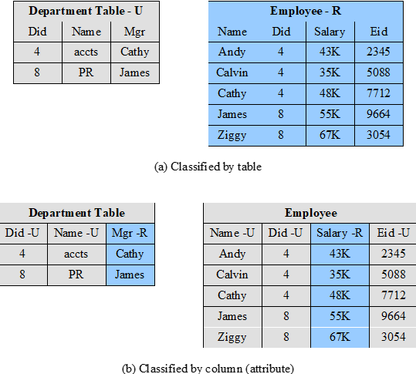
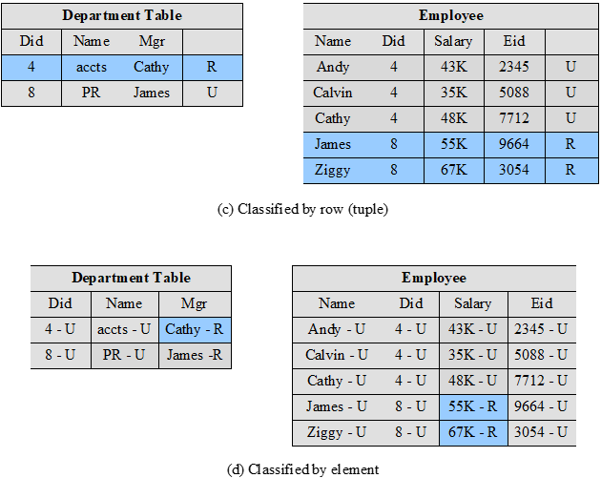
Fig. 13.9: Multi-Level Security for Databases
Notes:
The addition of multilevel security to a database system increases the complexity of
the access control function and of the design of the database itself. One key issue
is the granularity of classification. The following are possible methods of imposing
multilevel security on a relational database, in terms of the granularity of classification
( Figure 13.9 ):
• Entire database: This simple approach is easily accomplished on an MLS
platform. An entire database, such as a financial or personnel database,
could be classified as confidential or restricted and maintained on a server
with other files.
• Individual tables (relations): For some applications, it is appropriate to assign
classification at the table level. In the example of Figure 13.9a , two levels of
classification are defined: unrestricted (U) and restricted (R). The Employee
table contains sensitive salary information and is classified restricted, while
the Department table is unrestricted. This level of granularity is relatively easy
to implement and enforce.
• Individual columns (attributes): A security administrator may choose to
determine classification on the basis of attributes, so that selected columns
are classified. In the example of Figure 13.9b , the administrator determines
that salary information and the identity of department managers is restricted
information.

Slide 21
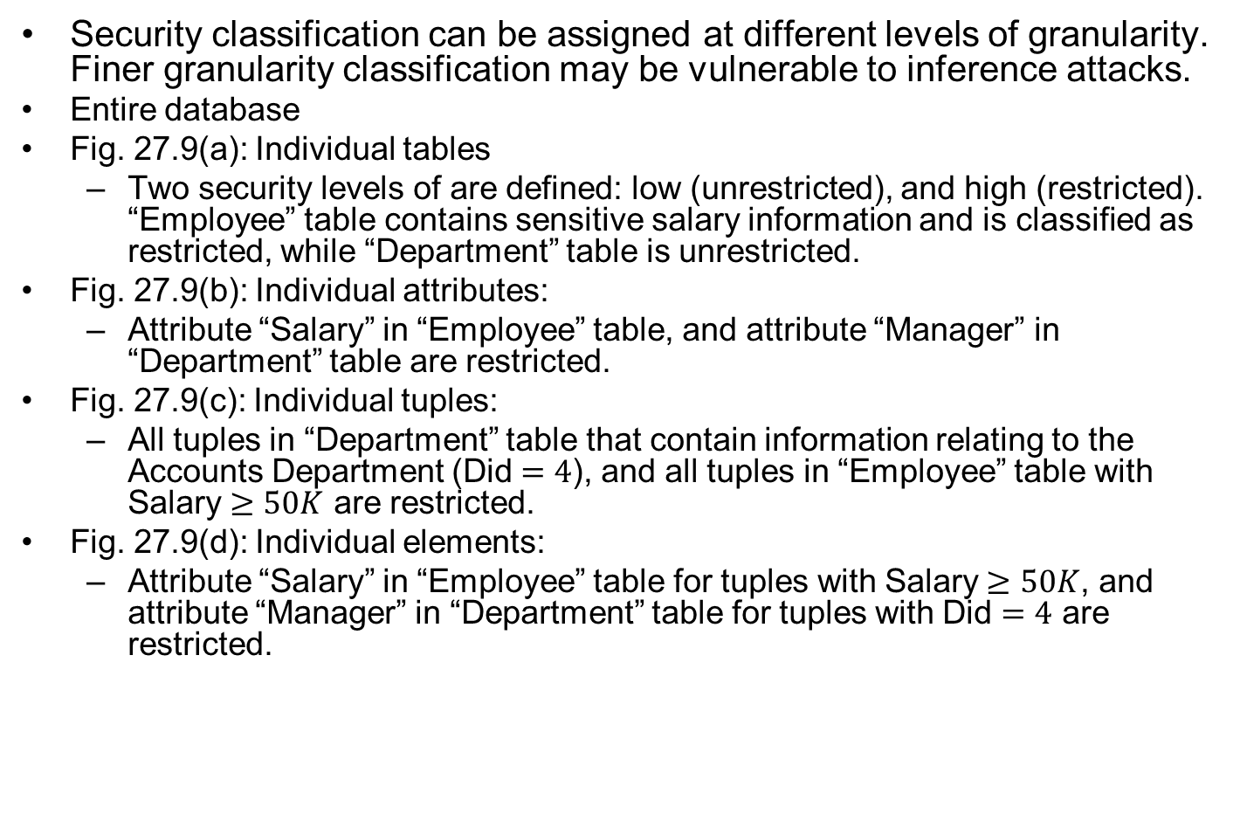
Fig. 13.9: Multi-Level Security for Databases Explanations
Security classification can be assigned at different levels of granularity. Finer granularity classification may be vulnerable to inference attacks.
Entire database
Fig. 27.9(a): Individual tables
  Two security levels of are defined: low (unrestricted), and high (restricted). “Employee” table contains sensitive salary information and is classified as restricted, while “Department” table is unrestricted.
Fig. 27.9(b): Individual attributes:
  Attribute “Salary” in “Employee” table, and attribute “Manager” in “Department” table are restricted.
Fig. 27.9(c): Individual tuples:
  All tuples in “Department” table that contain information relating to the Accounts Department (Did $=4$), and all tuples in “Employee” table with Salary $≥50K$ are restricted.
Fig. 27.9(d): Individual elements:
  Attribute “Salary” in “Employee” table for tuples with Salary $≥50K$, and attribute “Manager” in “Department” table for tuples with Did $=4$ are restricted.

Slide 22
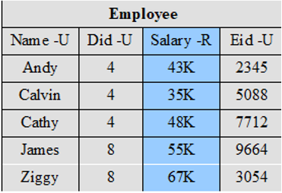
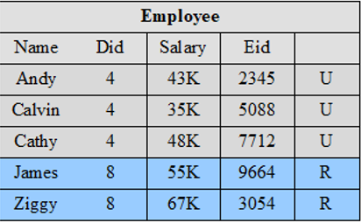
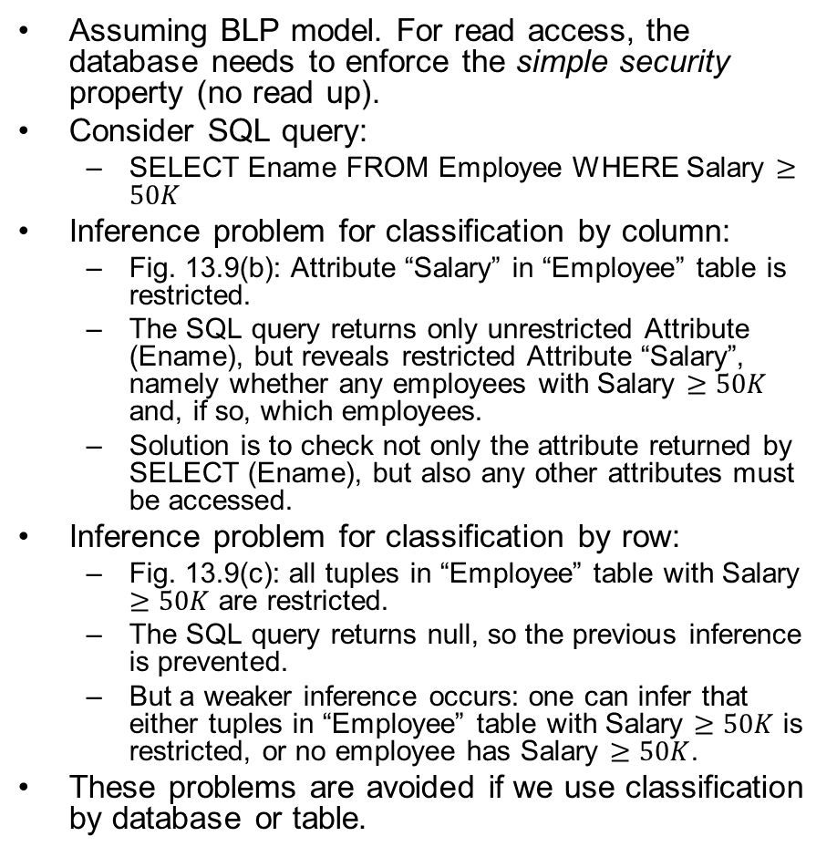
Database Security: Read Access
Assuming BLP model. For read access, the database needs to enforce the simple security property (no read up).
Consider SQL query:
  SELECT Ename FROM Employee WHERE Salary $≥50K$
Inference problem for classification by column:
  Fig. 13.9(b): Attribute “Salary” in “Employee” table is restricted.
  The SQL query returns only unrestricted Attribute (Ename), but reveals restricted Attribute “Salary”, namely whether any employees with Salary $≥50K$ and, if so, which employees.
  Solution is to check not only the attribute returned by SELECT (Ename), but also any other attributes must be accessed.
Inference problem for classification by row:
  Fig. 13.9(c): all tuples in “Employee” table with Salary $≥50K$ are restricted.
  The SQL query returns null, so the previous inference is prevented.
  But a weaker inference occurs: one can infer that either tuples in “Employee” table with Salary $≥50K$ is restricted, or no employee has Salary $≥50K$.
These problems are avoided if we use classification by database or table.
Fig. 13.9(b)
Fig. 13.9(c)
Notes:
For read access, a database system needs to enforce the simple
security rule (no read up). This is straightforward if the classification granularity
is the entire database or at the table level. Consider now a database classified by
column (attribute). For example, in Figure13.9b, suppose that a user with only
unrestricted clearance issues the following SQL query:
SELECT Ename
FROM Employee
WHERE Salary > 50K
This query returns only unrestricted data but reveals restricted information, namely
whether any employees have a salary greater than 50K and, if so, which employees.
This type of security violation can be addressed by considering not only the data
returned to the user but also any data that must be accessed to satisfy the query.
In this case, the query requires access to the Salary attribute, which is unauthorized
for this user; therefore, the query is rejected.
If classification is by row (tuple) rather than column, then the preceding query
does not pose an inference problem. Figure 13.10c shows that in the Employee table,
all rows corresponding to salaries greater than 50K are restricted. Because all such
records will be removed from the response to the preceding query, the inference
just discussed cannot occur. However, some information may be inferred, because a
null response indicates either that salaries above 50 are restricted, or no employee
has a salary greater than 50K.
The use of classification by rows instead of columns creates other inference
problems. For example, suppose we add a new Projects table to the database of
Figure13.9c consisting of attributes Eid, ProjectID, and ProjectName, where the
Eid field in the Employee and Projects tables can be joined. Suppose that all records
in the Projects table are unrestricted except for projects with ProjectID 500 through
599. Consider the following request:
SELECT Ename
WHERE Employee.Eid Projects.Eid
AND Projects.ProjectID 500
This request, if granted, returns information from the Employee table, which is
unrestricted, although it reveals restricted information, namely that the selected
employees are assigned to project 500. As before, the database system must consider
not just the data returned to the user but any data that must be accessed to satisfy
the query.
Classification by element does not introduce any new considerations. The
system must prevent not only a read up but also a query that must access higher-level
elements in order to satisfy the query.
As a general comment, we can say that dealing with read access is far simpler
if the classification granularity is database or table. If the entire database has a
single classification, then no new inference issues are raised. The same is true of
classification by table. If some finer-grained classification seems desirable, it might
be possible to achieve the same effect by splitting tables.

Slide 23
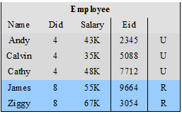
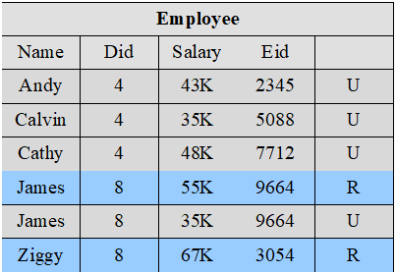
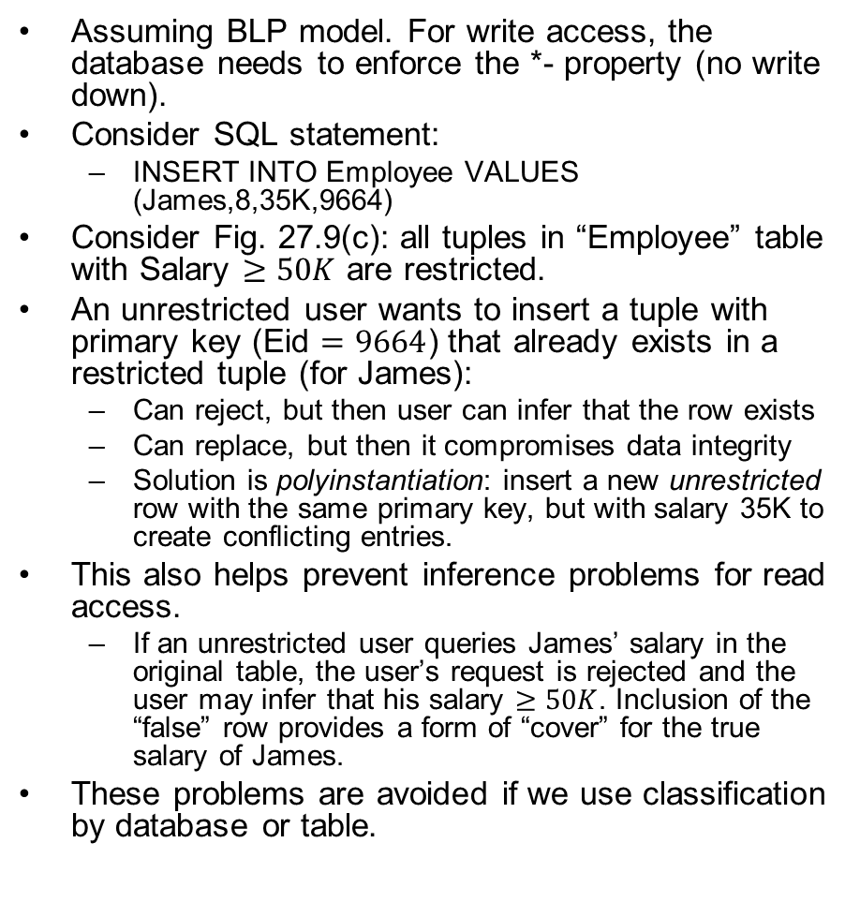
Database Security: Write Access
Assuming BLP model. For write access, the database needs to enforce the *- property (no write down).
Consider SQL statement:
  INSERT INTO Employee VALUES (James,8,35K,9664)
Consider Fig. 27.9(c): all tuples in “Employee” table with Salary $≥50K$ are restricted.
An unrestricted user wants to insert a tuple with primary key (Eid $=9664$) that already exists in a restricted tuple (for James):
  Can reject, but then user can infer that the row exists
  Can replace, but then it compromises data integrity
  Solution is polyinstantiation: insert a new unrestricted row with the same primary key, but with salary 35K to create conflicting entries.
This also helps prevent inference problems for read access.
  If an unrestricted user queries James’ salary in the original table, the user’s request is rejected and the user may infer that his salary $≥50K$. Inclusion of the “false” row provides a form of “cover” for the true salary of James.
These problems are avoided if we use classification by database or table.
Before insertion
After insertion with polyinstantiation
Notes:
The current row of James with Eid$=9664$ and with salary 55K is restricted, so we use polyinstantiation, and insert a new row of James with salary 35K, which is unrestricted.
For write access, a database system needs to enforce the *-security
rule (no write down). But this is not as simple as it may seem. Consider the following
situation. Suppose the classification granularity is finer than the table level (i.e., by
column, by row, or by element) and that a user with a low clearance (unrestricted)
requests the insertion of a row with the same primary key as an existing row where
the row or one of its elements is at a higher level. The DBMS has essentially three
choices:
. Notify the user that a row with the same primary key already exists and reject
the insertions. This is undesirable because it informs the user of the existence
of a higher-level row with the specified primary key value.
2. Replace the existing row with the new row classified at the lower level. This is
undesirable because it would allow the user to overwrite data not visible to the
user, thus compromising data integrity.
3. Insert the new row at the lower level without modifying the existing row at the
higher level. This is known as polyinstantiation . This avoids the inference and
data integrity problems but creates a database with conflicting entries.
The same alternatives apply when a user attempts to update a row rather than
insert a row. To illustrate the effect of polyinstantiation, consider the following
query applied to Figure 13.9c by a user with a low clearance (U).
INSERT INTO Employee
VALUES (James,8,35K,9664,U)
The table already contains a row for James with a higher salary level, which
necessitates classifying the row as restricted. This new tuple would have an unrestricted
classification. The same effect would be produced by an update:
UPDATE Employee
SET Salary35K
WHERE Eid9664
The result is unsettling ( Figure 13.10 ). Clearly, James can only have one salary
and therefore one of the two rows is false. The motivation for this is to prevent
inference. If a unrestricted user queries the salary of James in the original database,
the user’s request is rejected and the user may infer that salary is greater than 50K.
The inclusion of the “false” row provides a form of cover for the true salary of James.
Although the approach may appear unsatisfactory, there have been a number of
designs and implementations of polyinstantiation [BERT95].
The problem can be avoided by using a classification granularity of database
or table, and in many applications, such granularity is all that is needed.

Slide 24
Outline
Bell-LaPadula (BLP), Biba and Chinese wall model
Reference monitors for trusted systems
Application of multilevel security to databases
TCB and TPM
Common Criteria

Slide 25
Trusted Computing Base (TCB)and Trusted Platform Module (TPM)
TCB: the set of all hardware, firmware, and/or software components that are critical to its security. It provides 3 basic services
  Authenticated boot
  Certification
  Encryption
TPM: a secure hardware crypto-processor with integrated cryptographic keys.
Notes:
The trusted platform module (TPM) is a concept being standardized by an industry
consortium, the Trusted Computing Group. The TPM is a hardware module that
is at the heart of a hardware/software approach to trusted computing. Indeed, the
term trusted computing (TC) is now used in the industry to refer to this type of
hardware/software approach.
The TC approach employs a TPM chip in personal computer motherboard
or a smart card or integrated into the main processor, together with hardware and
software that in some sense has been approved or certified to work with the TPM.
We can briefly describe the TC approach as follows. The TPM generates keys that
it shares with vulnerable components that pass data around the system, such as
storage devices, memory components, and audio/visual hardware. The keys can be
used to encrypt the data that flow throughout the machine. The TPM also works
with TC-enabled software, including the OS and applications. The software can be
assured that the data it receives are trustworthy, and the system can be assured that
the software itself is trustworthy.
To achieve these features, TC provides three basic services: authenticated
boot, certification, and encryption.

Slide 26
Authenticated Boot Service
Responsible for booting entire OS in stages and ensuring each is valid and approved for use
  At each stage digital signature associated with code is verified
  TPM keeps a tamper-evident log of the loading process
Log records versions of all code (OS and application) that is running
  Can then expand trust boundary to include additional hardware and application and utility software
  Confirms component is on the approved list, is digitally signed, and that serial number hasn’t been revoked.
Result is a configuration that is well-defined with approved components
Notes:
The authenticated boot service is responsible for booting the entire operating
system in stages and assuring that each portion of the OS, as it is loaded, is a
version that is approved for use. Typically, an OS boot begins with a small piece
of code in the Boot ROM. This piece brings in more code from the Boot Block
on the hard drive and transfers execution to that code. This process continues
with more and larger blocks of the OS code being brought in until the entire OS
boot procedure is complete and the resident OS is booted. At each stage, the
TC hardware checks that valid software has been brought in. This may be done
by verifying a digital signature associated with the software. The TPM keeps a
tamper-evident log of the loading process, using a cryptographic hash function to
detect any tampering with the log.
When the process is completed, the tamper-resistant log contains a record that
establishes exactly which version of the OS and its various modules are running. It
is now possible to expand the trust boundary to include additional hardware and
application and utility software. The TC-enabled system maintains an approved list
of hardware and software components. To configure a piece of hardware or load a
piece of software, the system checks whether the component is on the approved list,
whether it is digitally signed (where applicable), and that its serial number hasn’t
been revoked. The result is a configuration of hardware, system software, and
applications that is in a well-defined state with approved components.

Slide 27
Certification Service
Once a configuration is achieved and logged the TPM can certify configuration to others
  Can produce a digital certificate
Confidence that configuration is unaltered because:
  TPM is considered trustworthy
  Only the TPM possesses this TPM’s private key
To assure that the certificate is both valid and up to date, a requester issues a “challenge” in the form of a random number when requesting a signed certificate from the TPM. The TPM signs a block of data consisting of the configuration information with the random number appended to it.
Provides a hierarchical certification approach
  Hardware/OS configuration
  OS certifies application programs
  User has confidence in application configuration
Notes:
Once a configuration is achieved and logged by the TPM, the TPM can certify the
configuration to other parties. The TPM can produce a digital certificate by signing
a formatted description of the configuration information using the TPM’s private
key. Thus, another user, either a local user or a remote system, can have confidence
that an unaltered configuration is in use because
1. The TPM is considered trustworthy. We do not need a further certification of
the TPM itself.
2. Only the TPM possesses this TPM’s private key. A recipient of the configuration
can use the TPM’s public key to verify the signature ( Figure 2.7b ).
To assure that the configuration is timely, a requester issues a “challenge” in
the form of a random number when requesting a signed certificate from the TPM.
The TPM signs a block of data consisting of the configuration information with
the random number appended to it. The requester therefore can verify that the
certificate is both valid and up to date.
The TC scheme provides for a hierarchical approach to certification. The
TPM certifies the hardware/OS configuration. Then the OS can certify the presence
and configuration of application programs. If a user trusts the TPM and trusts the
certified version of the OS, then the user can have confidence in the application’s
configuration.

Slide 28
Encryption Service
Encrypts data so that it can only be decrypted by a machine with a certain configuration
TPM maintains a master secret key unique to machine
  Used to generate secret encryption key for every possible configuration of that machine
Can extend scheme upward to application-level
  Provide encryption key to application so that decryption can only be done by desired version of application running on desired version of the desired OS
  Encrypted data can be stored locally or transmitted to a peer application on a remote machine
Notes:
The encryption service enables the encryption of data in such a way that the data
can be decrypted only by a certain machine and only if that machine is in a certain
configuration. There are several aspects of this service.
First, the TPM maintains a master secret key unique to this machine. From
this key, the TPM generates a secret encryption key for every possible configuration
of that machine. If data are encrypted while the machine is in one configuration, the
data can only be decrypted using that same configuration. If a different configuration
is created on the machine, the new configuration will not be able to decrypt the
data encrypted by a different configuration.
This scheme can be extended upward, as is done with certification. Thus, it is
possible to provide an encryption key to an application so that the application can
encrypt data, and decryption can only be done by the desired version of the desired
application running on the desired version of the desired OS. These encrypted data
can be stored locally, only retrievable by the application that stored them, or transmitted
to a peer application on a remote machine. The peer application would have
to be in the identical configuration to decrypt the data.

Slide 29
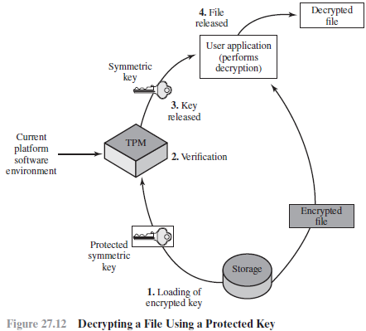
TPM for File Protection
A TPM protected file can be “sealed” to a particular software configuration (OS + applications), and only permits access if the current software config matches.
1. The symmetric key that was used to encrypt the file is stored with the file. The key itself is protected (encrypted) with another key to which the TPM has access. The protected key is submitted to the TPM with a request to reveal the key to the application.
2. Associated with the protected key is a specification of the software config that may have access to the key. The TPM verifies that the current config matches the config required for revealing the key. In addition, the requesting application must be authorized to access the key.
3. If the current config is permitted access to the protected key, then the TPM decrypts the key and passes it on to the application.
4. The application uses the key to decrypt the file.
Notes:
To give some feeling for the operation of a TC/TPM system, we look at the
protected storage function. The TPM generates and stores a number of encryption
keys in a trust hierarchy. At the root of the hierarchy is a storage root key generated
by the TPM and accessible only for the TPM’s use. From this key other keys
can be generated and protected by encryption with keys closer to the root of the
hierarchy.
An important feature of Trusted Platforms is that a TPM protected object can
be “sealed” to a particular software state in a platform. When the TPM protected
object is created, the creator indicates the software state that must exist if the secret
is to be revealed. When a TPM unwraps the TPM protected object (within the TPM
and hidden from view), the TPM checks that the current software state matches the
indicated software state. If they match, the TPM permits access to the secret. If they
don’t match, the TPM denies access to the secret.
Figure 13.12 provides an example of this protection. In this case, there is an
encrypted file on local storage that a user application wishes to access. The following
steps occur:
1. The symmetric key that was used to encrypt the file is stored with the file.
The key itself is encrypted with another key to which the TPM has access. The
protected key is submitted to the TPM with a request to reveal the key to the
application.
2. Associated with the protected key is a specification of the hardware/software
configuration that may have access to the key. The TPM verifies that the
current configuration matches the configuration required for revealing the key.
In addition, the requesting application must be specifically authorized to access
the key. The TPM uses an authorization protocol to verify authorization.
3. If the current configuration is permitted access to the protected key, then the
TPM decrypts the key and passes it on to the application.
4. The application uses the key to decrypt the file. The application is trusted to
then securely discard the key.

Slide 30
TPM Component Architecture (Typical)

Slide 31
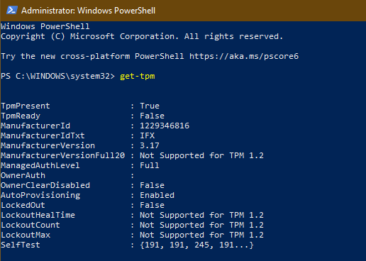
TPM on Windows
To check the status of TPM on your computer, you can either use TPM.msc management console or get-tpm in a PowerShell session. (Requires administrator rights.)
https://www.nextofwindows.com/how-to-clear-and-manage-tpm-on-windows-10
Notes:
Figure 13.11 , based on the most recent TPM specification, is a block diagram of the
functional components of the TPM. These are as follows:
• I/O: All commands enter and exit through the I/O component, which provides
communication with the other TPM components.
• Cryptographic co-processor: Includes a processor that is specialized for
encryption and related processing. The specific cryptographic algorithms
implemented by this component include RSA encryption/decryption,
RSA-based digital signatures, and symmetric encryption.
• Key generation: Creates RSA public/private key pairs and symmetric keys.
• HMAC engine: This algorithm is used in various authentication protocols.
• Random number generator (RNG): This component produces random numbers
used in a variety of cryptographic algorithms, including key generation, random
values in digital signatures, and nonces. A nonce is a random number used once,
as in a challenge protocol. The RNG uses a hardware source of randomness
(manufacturer specific) and does not rely on a software algorithm that produces
pseudo random numbers.
SHA-1 engine: This component implements the SHA algorithm, which is used
in digital signatures and the HMAC algorithm.
• Power detection: Manages the TPM power states in conjunction with the
platform power states.
• Opt-in: Provides secure mechanisms to allow the TPM to be enabled or
disabled at the customer/user’s discretion.
• Execution engine: Runs program code to execute the TPM commands
received from the I/O port.
• Nonvolatile memory: Used to store persistent identity and state parameters
for this TPM.
• Volatile memory: Temporary storage for execution functions, plus storage
of volatile parameters, such as current TPM state, cryptographic keys, and
session information.

Slide 32
Outline
Bell-LaPadula (BLP), Biba and Chinese Wall model
Reference monitors for trusted systems
Application of multilevel security to databases
TCB and TPM
Common Criteria

Slide 33
Common Criteria
ISO standard for security evaluation
Aim is to provide greater confidence in IT product security
  Development using secure requirements
  Evaluation confirming meets requirements
  Operation in accordance with requirements
Following successful evaluation a product may be listed as CC certified
  7 Evaluation Assurance Levels (EALs)
EAL 1: Functionally tested
EAL 2: Structurally tested
EAL 3: Methodically tested and checked
EAL 4: Methodically designed, tested, and reviewed
EAL 5: Semi-formally designed and tested
EAL 6: Semi-formally verified design and tested
EAL 7: Formally verified design and tested
Notes:
The work done by the National Security Agency and other U.S. government agencies
to develop requirements and evaluation criteria for trusted systems resulted
in the publication of the Trusted Computer System Evaluation Criteria (TCSEC),
informally known as the Orange Book , in the early 1980s. This focused primarily on
protecting information confidentiality. Subsequently, other countries started work
to develop criteria based on the TCSEC but that were more flexible and adaptable
to the evolving nature of IT. The process of merging, extending, and consolidating
these various efforts eventually resulted in the development of the Common
Criteria in the late 1990s. The Common Criteria (CC) for Information Technology
and Security Evaluation are ISO standards for specifying security requirements
and defining evaluation criteria. The aim of these standards is to provide greater
confidence in the security of IT products as a result of formal actions taken during
the process of developing, evaluating, and operating these products. In the
development stage, the CC defines sets of IT requirements of known validity
that can be used to establish the security requirements of prospective products
and systems. Then the CC details how a specific product can be evaluated against
these known requirements, to provide confirmation that it does indeed meet them,
with an appropriate level of confidence. Lastly, when in operation the evolving
IT environment may reveal new vulnerabilities or concerns. The CC details a
process for responding to such changes, and possibly reevaluating the product.
Following successful evaluation, a particular product may be listed as CC certified
or validated by the appropriate national agency, such as NIST/NSA in the United
States. That agency publishes lists of evaluated products, which are used by
government and industry purchasers who need to use such products.

