Slide 1
CH04 Access Control
Zonghua Gu
2017, ZJU
Notes:
This chapter provides an overview of computer security. We begin with a discussion
of what we mean by computer security. In essence, computer security deals
with computer-related assets that are subject to a variety of threats and for which
various measures are taken to protect those assets. Accordingly, the next section of
this chapter provides a brief overview of the categories of computer-related assets
that users and system managers wish to preserve and protect, and a look at the
various threats and attacks that can be made on those assets. Then, we survey the
measures that can be taken to deal with such threats and attacks. This we do from
three different viewpoints, in Sections 1.3 through 1.5. We then lay out in general
terms a computer security strategy.
The focus of this chapter, and indeed this book, is on three fundamental
questions:
1. What assets do we need to protect?
2. How are those assets threatened?
3. What can we do to counter those threats?

Slide 2
Outline
Introduction
Discretionary Access Control (DAC)
  UNIX file access control
Role-based Access Control (RBAC)
Attribute-Based Access Control (ABAC)
Bank RBAC system

Slide 3
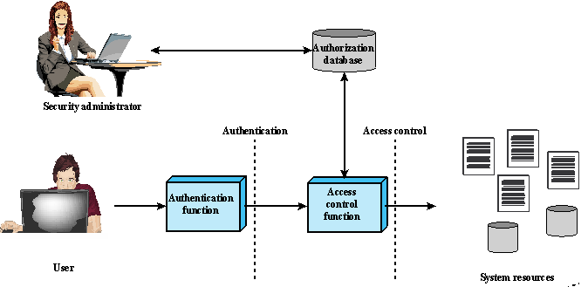
Authentication and Access Control
Authentication: verifies the credentials of a user to determine if the user is permitted to access the system at all.
  e.g., is the current user trying to log in with John’s user ID really John himself?
Access control: mediates between a user and system resources (files and databases), and determines if the specific requested access is permitted.
  e.g., should John’s process making a request to read a certain file be allowed to do so?
Notes:
As was previously stated, a discretionary access control scheme is one in which an
entity may be granted access rights that permit the entity, by its own volition, to
enable another entity to access some resource. A general approach to DAC, as
exercised by an operating system or a database management system, is that of an
access matrix. The access matrix concept was formulated by Lampson [LAMP69,
LAMP71], and subsequently refined by Graham and Denning [GRAH72, DENN71]
and by Harrison et al. [HARR76].
One dimension of the matrix consists of identified subjects that may attempt
data access to the resources. Typically, this list will consist of individual users or
user groups, although access could be controlled for terminals, network equipment,
hosts, or applications instead of or in addition to users. The other dimension lists
the objects that may be accessed. At the greatest level of detail, objects may be
individual data fields. More aggregate groupings, such as records, files, or even the
entire database, may also be objects in the matrix. Each entry in the matrix indicates
the access rights of a particular subject for a particular object.

Slide 4
Access Control Policies
Discretionary Access Control (DAC)
  Controls access based on the identity of the requestor and on access rules (authorizations) stating what requestors are (or are not) allowed to do
  A user may grant access rights to another user
Mandatory Access Control (MAC)
  Controls access based on comparing security labels with security clearances
  A user may not grant access rights to another user
  Covered in L5-CH27-Trusted Computing.
Role-Based Access Control (RBAC)
  Controls access based on the roles that users have within the system and on rules stating what accesses are allowed to users in given roles
Attribute-Based Access Control (ABAC)
  Controls access based on attributes of the user, the resource to be accessed, and current environmental conditions
Notes:
An access control policy, which can be embodied in an authorization database,
dictates what types of access are permitted, under what circumstances, and by
whom. Access control policies are generally grouped into the following categories:
• Discretionary access control (DAC): Controls access based on the identity
of the requestor and on access rules (authorizations) stating what requestors
are (or are not) allowed to do. This policy is termed discretionary because an
entity might have access rights that permit the entity, by its own volition, to
enable another entity to access some resource.
• Mandatory access control (MAC): Controls access based on comparing
security labels (which indicate how sensitive or critical system resources are)
with security clearances (which indicate system entities are eligible to access
certain resources). This policy is termed mandatory because an entity that has
clearance to access a resource may not, just by its own volition, enable another
entity to access that resource.
• Role-based access control (RBAC): Controls access based on the roles that
users have within the system and on rules stating what accesses are allowed to
users in given roles.
• Attribute-based access control (ABAC): Controls access based on attributes
of the user, the resource to be accessed, and current environmental
conditions.
DAC is the traditional method of implementing access control, and is examined
in Sections 4.3 and 4.4. MAC is a concept that evolved out of requirements for
military information security and is best covered in the context of trusted systems,
which we deal with in Chapter 13. Both RBAC and ABAC have become increasingly
popular, and are examined in Sections 4.5 and 4.6, respectively.
These four policies are not mutually exclusive. An access control mechanism
can employ two or even all three of these policies to cover different classes of system
resources.

Slide 5
Subjects, Objects, and Access Rights
Subject
  An active entity capable of accessing objects
Object
  A resource to which access is controlled
Access right
  The way in which a subject may access an object
  Could include: Read, Write, Execute, Delete, Create, Search
Notes:
A subject is an active entity that causes information to flow among objects or changes the system state
Attributes define identity and characteristics of the subject
Object attributes
An object (resource) is a passive entity containing or receiving information
The basic elements of access control are: subject, object, and access right.
Entity used to contain and/or receive information
A subject is an entity capable of accessing objects. Generally, the concept of
subject equates with that of process. Any user or application actually gains access to
an object by means of a process that represents that user or application. The process
takes on the attributes of the user, such as access rights.
A subject is typically held accountable for the actions they have initiated,
and an audit trail may be used to record the association of a subject with security relevant
actions performed on an object by the subject.
Basic access control systems typically define three classes of subject, with
different access rights for each class:
• Owner: This may be the creator of a resource, such as a file. For system resources,
ownership may belong to a system administrator. For project resources, a project
administrator or leader may be assigned ownership.
• Group: In addition to the privileges assigned to an owner, a named group of
users may also be granted access rights, such that membership in the group is
sufficient to exercise these access rights. In most schemes, a user may belong
to multiple groups.
• World: The least amount of access is granted to users who are able to access the
system but are not included in the categories owner and group for this resource.
An object is a resource to which access is controlled. In general, an object
is an entity used to contain and/or receive information. Examples include records,
blocks, pages, segments, files, portions of files, directories, directory trees, mailboxes,
messages, and programs. Some access control systems also encompass, bits,
bytes, words, processors, communication ports, clocks, and network nodes.
The number and types of objects to be protected by an access control system
depends on the environment in which access control operates and the desired tradeoff
between security on the one hand and complexity, processing burden, and ease
of use on the other hand.
An access right describes the way in which a subject may access an object.
Access rights could include the following:
• Read: User may view information in a system resource (e.g., a file, selected
records in a file, selected fields within a record, or some combination). Read
access includes the ability to copy or print.
• Write: User may add, modify, or delete data in system resource (e.g., files,
records, programs). Write access includes read access.
• Execute: User may execute specified programs.
• Delete: User may delete certain system resources, such as files or records.
• Create: User may create new files, records, or fields.
• Search: User may list the files in a directory or otherwise search the directory.

Slide 6
Outline
Introduction
Discretionary Access Control (DAC)
  UNIX file access control
Role-based Access Control (RBAC)
Attribute-Based Access Control (ABAC)
Bank RBAC system

Slide 7
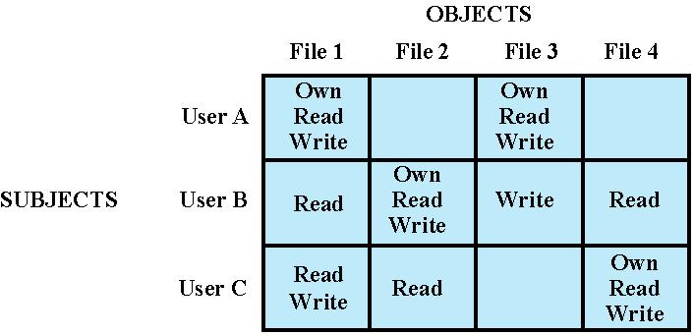
Discretionary Access Control (DAC)
The Access Control Matrix
  Each entry indicates the access rights of a subject for an object
  A user may enable another user to access some resource
Notes:
As was previously stated, a discretionary access control scheme is one in which an
entity may be granted access rights that permit the entity, by its own volition, to
enable another entity to access some resource. A general approach to DAC, as
exercised by an operating system or a database management system, is that of an
access matrix. The access matrix concept was formulated by Lampson [LAMP69,
LAMP71], and subsequently refined by Graham and Denning [GRAH72, DENN71]
and by Harrison et al. [HARR76].
One dimension of the matrix consists of identified subjects that may attempt
data access to the resources. Typically, this list will consist of individual users or
user groups, although access could be controlled for terminals, network equipment,
hosts, or applications instead of or in addition to users. The other dimension lists
the objects that may be accessed. At the greatest level of detail, objects may be
individual data fields. More aggregate groupings, such as records, files, or even the
entire database, may also be objects in the matrix. Each entry in the matrix indicates
the access rights of a particular subject for a particular object.

Slide 8
An access matrix is usually sparse and is implemented by decomposition in one of two ways: access control list (used by Linux), or capability list (used by L4).
Notes:
In practice, an access matrix is usually sparse and is implemented by decomposition
in one of two ways. The matrix may be decomposed by columns, yielding
access control lists (ACLs); see Figure 4.2b. For each object, an ACL lists users and
their permitted access rights. The ACL may contain a default, or public, entry. This
allows users that are not explicitly listed as having special rights to have a default
set of rights. The default set of rights should always follow the rule of least privilege
or read-only access, whichever is applicable. Elements of the list may include
individual users as well as groups of users.
When it is desired to determine which subjects have which access rights to a particular
resource, ACLs are convenient, because each ACL provides the information
for a given resource. However, this data structure is not convenient for determining
the access rights available to a specific user.
Decomposition by rows yields capability tickets (Figure 4.2c). A capability
ticket specifies authorized objects and operations for a particular user. Each user
has a number of tickets and may be authorized to loan or give them to others.
Because tickets may be dispersed around the system, they present a greater
security problem than access control lists. The integrity of the ticket must be
protected, and guaranteed (usually by the operating system). In particular, the
ticket must be unforgeable. One way to accomplish this is to have the operating
system hold all tickets on behalf of users. These tickets would have to be held in
a region of memory inaccessible to users. Another alternative is to include an
unforgeable token in the capability. This could be a large random password, or a
cryptographic message authentication code. This value is verified by the relevant
resource whenever access is requested. This form of capability ticket is appropriate
for use in a distributed environment, when the security of its contents cannot
be guaranteed.
The convenient and inconvenient aspects of capability tickets are the opposite
of those for ACLs. It is easy to determine the set of access rights that a given user
has, but more difficult to determine the list of users with specific access rights for a
specific resource.

Slide 9
Extended Access Control Matrix
Objects may be files, processes, disk drives, or other subjects
Notes:
This section introduces a general model for DAC developed by Lampson, Graham,
and Denning [LAMP71, GRAH72, DENN71]. The model assumes a set of subjects,
a set of objects, and a set of rules that govern the access of subjects to objects. Let us
define the protection state of a system to be the set of information, at a given point in
time, that specifies the access rights for each subject with respect to each object. We can
identify three requirements: representing the protection state, enforcing access rights,
and allowing subjects to alter the protection state in certain ways. The model addresses
all three requirements, giving a general, logical description of a DAC system.
To represent the protection state, we extend the universe of objects in the
access control matrix to include the following:
• Processes: Access rights include the ability to delete a process, stop (block),
and wake up a process.
• Devices: Access rights include the ability to read/write the device, to control
its operation (e.g., a disk seek), and to block/unblock the device for use.
• Memory locations or regions: Access rights include the ability to read/write
certain regions of memory that are protected such that the default is to disallow
access.
• Subjects: Access rights with respect to a subject have to do with the ability to grant
or delete access rights of that subject to other objects, as explained subsequently.
Figure 4.3 is an example. For an access control matrix A, each entry A[S, X]
contains strings, called access attributes, that specify the access rights of subject S to
object X. For example, in Figure 4.3, S₁ may read file F₂, because ‘read’ appears in
A[S₁, F₁].

Slide 10
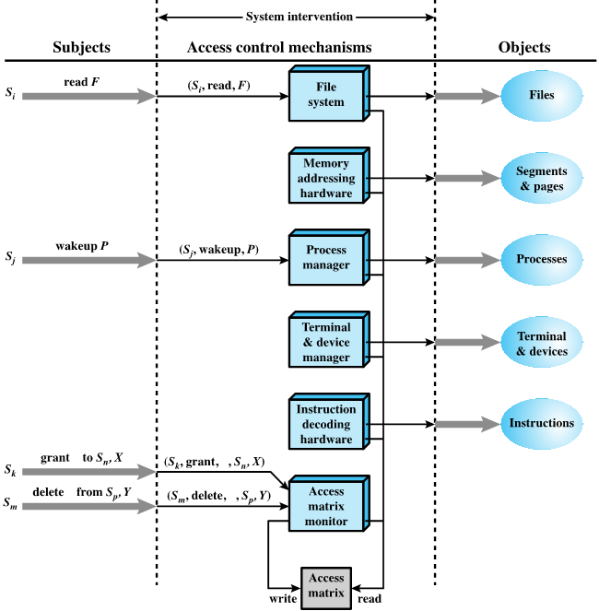
Architecture of Access Control
Every access by a subject to an object is mediated by the controller for that object, and that the controller’s decision is based on the current contents of the matrix.
Certain subjects can modify the access matrix. A request to modify the access matrix is treated as an access to the matrix, with the individual entries in the matrix treated as objects. Such accesses are mediated by an access matrix controller, which controls updates to the matrix.

Slide 11
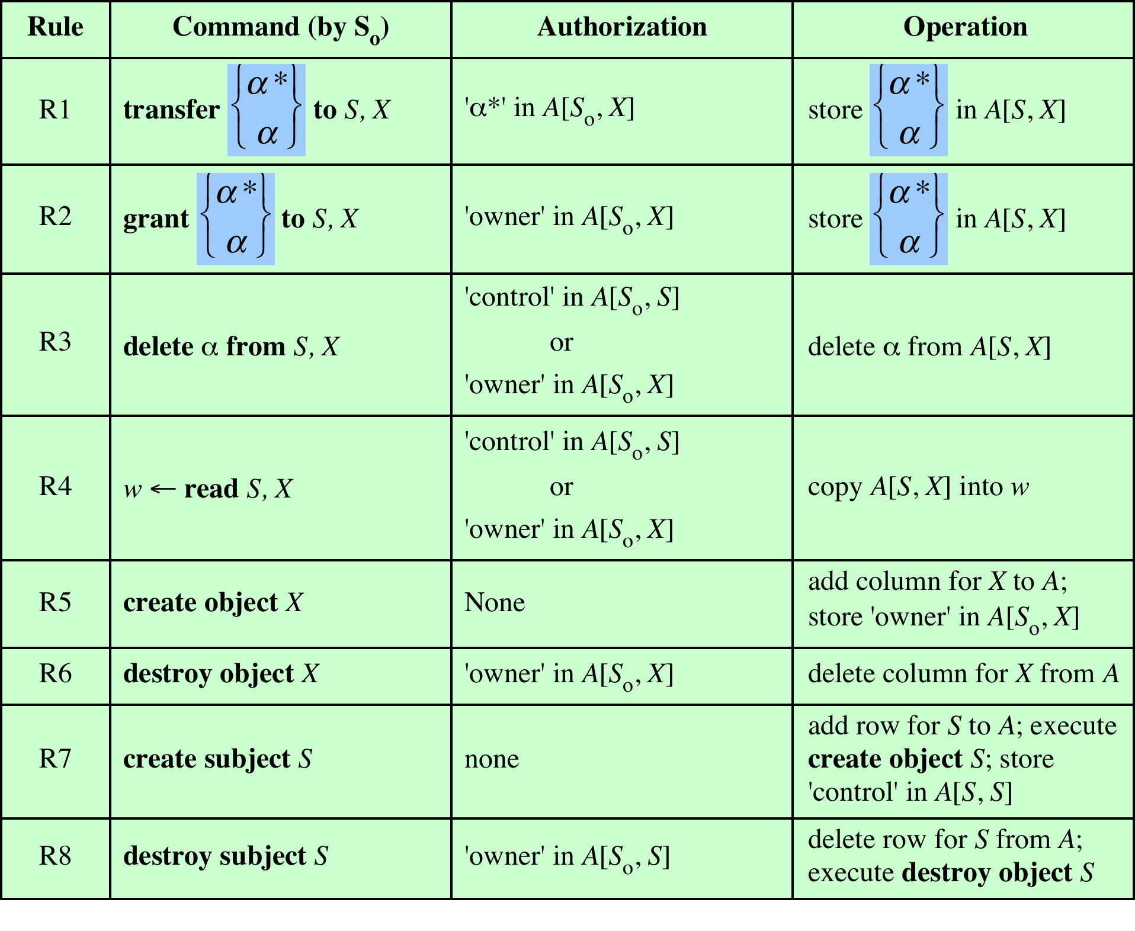
Table 4.2
Access Control System Commands
Notes:
The model also includes a set of rules that govern modifications to the access
matrix, shown in Table 4.2. For this purpose, we introduce the access rights ‘owner’
and ‘control’ and the concept of a copy flag, explained in the subsequent paragraphs.
The first three rules deal with transferring, granting, and deleting access rights.
Suppose that the entry α* exists in A[S₀, X]. This means that S₀ has access right α to
subject X and, because of the presence of the copy flag, can transfer this right, with
or without copy flag, to another subject. Rule R1 expresses this capability. A subject
would transfer the access right without the copy flag if there were a concern that
the new subject would maliciously transfer the right to another subject that should
not have that access right. For example, S₁ may place ‘read’ or ‘read*’ in any matrix
entry in the F₁ column. Rule R2 states that if S₀ is designated as the owner of object
X, then S₀ can grant an access right to that object for any other subject. Rule 2 states
that S₀ can add any access right to A[S, X] for any S, if S₀ has ‘owner’ access to x.
Rule R3 permits S₀ to delete any access right from any matrix entry in a row for
which S₀ controls the subject and for any matrix entry in a column for which S₀ owns
the object. Rule R4 permits a subject to read that portion of the matrix that it owns
or controls.
The remaining rules in Table 4.2 govern the creation and deletion of subjects
and objects. Rule R5 states that any subject can create a new object, which it
owns, and can then grant and delete access to the object. Under rule R6, the owner
of an object can destroy the object, resulting in the deletion of the corresponding
column of the access matrix. Rule R7 enables any subject to create a new subject;
the creator owns the new subject and the new subject has control access to itself.
Rule R8 permits the owner of a subject to delete the row and column (if there are
subject columns) of the access matrix designated by that subject.
The set of rules in Table 4.2 is an example of the rule set that could be defined
for an access control system. The following are examples of additional or alternative
rules that could be included. A transfer-only right could be defined, which results in
the transferred right being added to the target subject and deleted from the transferring
subject. The number of owners of an object or a subject could limited to one by
not allowing the copy flag to accompany the owner right.

Slide 12
Table 4.2 Explanations
The first three rules deal with transferring, granting, and deleting access rights.
R1: If the entry α* exists in A[S₀, X], then S₀ has access right α to subject X and, because of the presence of the copy flag, can transfer this right, with or without copy flag, to another subject. A subject would transfer the access right without the copy flag if there were a concern that the new subject would maliciously transfer the right to another subject that should not have that access right.
R2 states that if S₀ is designated as the owner of object X, then S₀ can grant an access right to that object X for any other subject S.
R3 permits S₀ to delete any access right from any matrix entry in a row for which S₀ controls the subject and for any matrix entry in a column for which S₀ owns the object.
R4 permits a subject to read that portion of the matrix that it owns or controls.
The remaining rules govern the creation and deletion of subjects and objects.
R5: any subject can create a new object, which it owns, and can then grant and delete access to the object.
R6: the owner of an object can destroy the object, resulting in the deletion of the corresponding column of the access matrix.
R7 enables any subject to create a new subject; the creator owns the new subject and the new subject has control access to itself.
R8 permits the owner of a subject to delete the row and column (if there are subject columns) of the access matrix designated by that subject.

Slide 13
DAC Quiz
Assume user Alice is the owner of file foo, and can choose to grant read access right to foo to another user Bob, but can prevent Bob from further granting read access right to other users
  “grant r to {Bob, foo}” instead of “grant r* to {Bob, foo}”
Q: Does this ensure that a third user, Charlie, can never read data from file foo?
ANS: No. Bob cannot issue “grant r to {Charlie, foo}”, but he can make a copy of foo, foo2, so now he is the owner of foo2 and can issue “grant r to {Charlie, foo2}”
  If Alice issues “grant w to {Bob, foo}”, the Charlie cannot possibly write to foo.

Slide 14
DAC Example: UNIX File Access Control
For a given file, there are 3 classes of subjects, with different access rights for each class:
  Owner: the file’s owner
  Group: a user may belong to multiple groups
  Other: all other users, who are neither the owner, nor members of any group relevant to the file
  Each class of subjects has 3 types of permission: read (r), write (w), execute (x)
Notes:
For our discussion of UNIX file access control, we first introduce several basic
concepts concerning UNIX files and directories.
; ownership can be changed with “chown” command
A named group of users may be granted access rights;
All types of UNIX files are administered by the operating system by means of
inodes. An inode (index node) is a control structure that contains the key information
needed by the operating system for a particular file. Several file names may be
associated with a single inode, but an active inode is associated with exactly one file,
and each file is controlled by exactly one inode. The attributes of the file as well as
its permissions and other control information are stored in the inode. On the disk,
there is an inode table, or inode list, that contains the inodes of all the files in the file
system. When a file is opened, its inode is brought into main memory and stored in
a memory-resident inode table.
Directories are structured in a hierarchical tree. Each directory can contain
files and/or other directories. A directory that is inside another directory is referred
to as a subdirectory. A directory is simply a file that contains a list of file names plus
pointers to associated inodes. Thus, associated with each directory is its own inode.

Slide 15
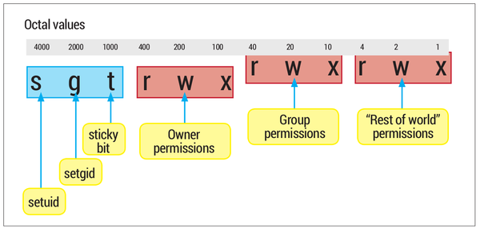
UNIX File Permission Bits
Each UNIX user is assigned a unique user ID (root has ID 0). A user is also a member of a primary group, and possibly a member of other groups, each identified by a group ID.
When a file is created, its owner is user ID of its creator, and its group ID is its creator’s primary group, but they can be changed later.
  e.g., command “chown root passwd” sets owner of file “passwd” to root.
12 permission bits; 9 bits specify read, write, and execute permission for user (owner), group, and all other users
  e.g., command “chmod 640 file1” sets file1’s permissions to be readable and writable by owner, readable by group. (Decimal number 640 is 110 100 000 in binary)
The other 3 bits are Set-UID, Set-GID (used in Lab1) and Sticky bit (used in Lab2)
Notes:
Most UNIX systems depend on, or at least are based on, the file access control
scheme introduced with the early versions of UNIX. Each UNIX user is assigned
a unique user identification number (user ID). A user is also a member of a primary
group, and possibly a number of other groups, each identified by a group ID.
When a file is created, it is designated as owned by a particular user and marked
with that user’s ID. It also belongs to a specific group, which initially is either its
creator’s primary group, or the group of its parent directory if that directory has
SetGID permission set. Associated with each file is a set of 12 protection bits. The
owner ID, group ID, and protection bits are part of the file’s inode.
Nine of the protection bits specify read, write, and execute permission for the
owner of the file, other members of the group to which this file belongs, and all other
users. These form a hierarchy of owner, group, and all others, with the highest relevant
set of permissions being used. Figure 4.5a shows an example in which the file owner has
read and write access; all other members of the file’s group have read access, and users
outside the group have no access rights to the file. When applied to a directory, the read
and write bits grant the right to list and to create/rename/delete files in the directory.
The execute bit grants to right to descend into the directory or search it for a filename.

Slide 16
Drawbacks of Permission Bits
The permission bits scheme becomes unwieldy when a large number of user groups are needed to assign access rights to different files
For example, suppose a user wants to give read access for file X to users A and B and read access for file Y to users B and C. At least two user groups are needed, and user B would need to belong to both groups in order to access the two files.
A
B
C
File X’s group
File Y’s group

Slide 17
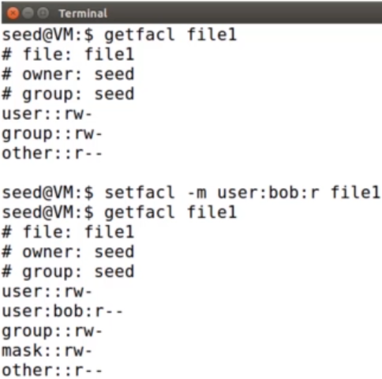
Access Control Lists (ACLs) in UNIX
Modern UNIX systems support ACL, called “facl (full access control list)”, which is more expressive than permission bits.
“getfacl file1”
  Display file1’s facl
“setfacl –m user:bob:r file1”
  Grant user:bob read permission to file1.
  Can associate any number of users or groups with a file, each with 3 protection bits (rwx).
Notes:
When a process requests access to a file system object two steps are performed:
Step 1 selects the most appropriate ACL
Step 2 checks if the matching entry contains sufficient permissions
Assigns a list of UNIX user IDs and groups to a file
This access scheme is adequate when file access requirements align with users
and a modest number of groups of users. For example, suppose a user wants to give
read access for file X to users A and B and read access for file Y to users B and C. We
would need at least two user groups, and user B would need to belong to both groups
in order to access the two files. However, if there are a large number of different
groupings of users requiring a range of access rights to different files, then a very large
number of groups may be needed to provide this. This rapidly becomes unwieldy and
difficult to manage, even if possible at all. One way to overcome this problem is to use
access control lists, which are provided in most modern UNIX systems.
A final point to note is that the traditional UNIX file access control scheme
implements a simple protection domain structure. A domain is associated with the
user, and switching the domain corresponds to changing the user ID temporarily.
Many modern UNIX and UNIX-based operating systems support access control
lists, including FreeBSD, OpenBSD, Linux, and Solaris. In this section, we describe
FreeBSD, but other implementations have essentially the same features and interface.
The feature is referred to as extended access control list, while the traditional
UNIX approach is referred to as minimal access control list.
FreeBSD allows the administrator to assign a list of UNIX user IDs and groups
to a file by using the setfacl command. Any number of users and groups can be
associated with a file, each with three protection bits (read, write, execute), offering a
flexible mechanism for assigning access rights. A file need not have an ACL but may be
protected solely by the traditional UNIX file access mechanism. Free BSD files include
an additional protection bit that indicates whether the file has an extended ACL.

Slide 18
Outline
Introduction
Discretionary Access Control (DAC)
  UNIX file access control
Role-based Access Control (RBAC)
Attribute-Based Access Control (ABAC)
Bank RBAC system

Slide 19
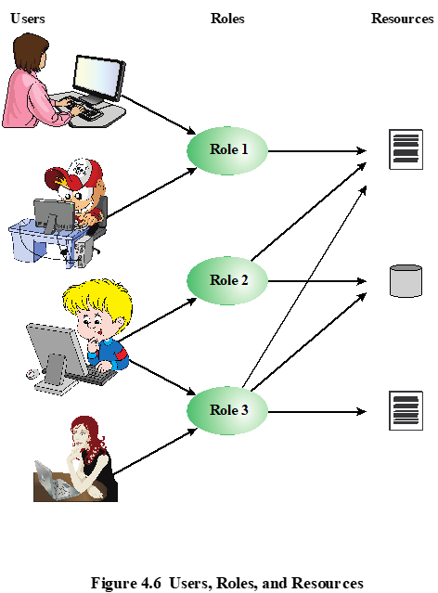
RBAC is based on the roles that users assume in a system rather than the user’s identity; Access rights are assigned to roles instead of users
  e.g., a user in the Accounts Payable clerk position would be assigned the AP Role in the accounting system
The relationship of users to roles is many-to-many
The set of users may change frequently, but the set of roles is likely to be relatively static, with only occasional additions or deletions
Notes:
Traditional DAC systems define the access rights of individual users and groups
of users. In contrast, RBAC is based on the roles that users assume in a system
rather than the user’s identity. Typically, RBAC models define a role as a job function
within an organization. RBAC systems assign access rights to roles instead of
individual users. In turn, users are assigned to different roles, either statically or
dynamically, according to their responsibilities.
RBAC now enjoys widespread commercial use and remains an area of active
research. The National Institute of Standards and Technology (NIST) has issued a
standard, Security Requirements for Cryptographic Modules (FIPS PUB 140-3, September 2009),
that requires support for access control and administration through roles.
The relationship of users to roles is many to many, as is the relationship of
roles to resources, or system objects (Figure 4.6). The set of users changes, in some
environments frequently, and the assignment of a user to one or more roles may
also be dynamic. The set of roles in the system in most environments is relatively
static, with only occasional additions or deletions. Each role will have specific access
rights to one or more resources. The set of resources and the specific access rights
associated with a particular role are also likely to change infrequently.

Slide 20
The upper matrix relates users to roles; The lower matrix relates roles to objects.
Notes:
We can use the access matrix representation to depict the key elements of an
RBAC system in simple terms, as shown in Figure 4.7. The upper matrix relates
individual users to roles. Typically there are many more users than roles. Each matrix
entry is either blank or marked, the latter indicating that this user is assigned to this
role. Note that a single user may be assigned multiple roles (more than one mark in a
row) and that multiple users may be assigned to a single role (more than one mark in
a column). The lower matrix has the same structure as the DAC access control matrix,
with roles as subjects. Typically, there are few roles and many objects, or resources.
In this matrix the entries are the specific access rights enjoyed by the roles. Note that a
role can be treated as an object, allowing the definition of role hierarchies.
RBAC lends itself to an effective implementation of the principle of least
privilege, referred to in Chapter 1. Each role should contain the minimum set of
access rights needed for that role. A user is assigned to a role that enables him or her
to perform only what is required for that role. Multiple users assigned to the same
role, enjoy the same minimal set of access rights.

Slide 21
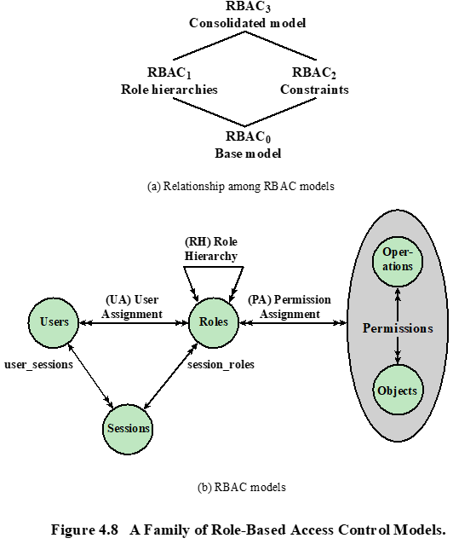
RBAC Models
Models | Hierarchies | Constraints
RBAC₀ | No | No
RBAC₁ | Yes | No
RBAC₂ | No | Yes
RBAC₃ | Yes | Yes
Notes:
A variety of functions and services can be included under the general RBAC
approach. To clarify the various aspects of RBAC, it is useful to define a set of
abstract models of RBAC functionality.
[SAND96] defines a family of reference models that has served as the basis
for ongoing standardization efforts. This family consists of four models that are
related to each other as shown in Figure 4.8a. and Table 4.3. RBAC₀ contains the
minimum functionality for an RBAC system. RBAC₁ includes the RBAC₀ functionality
and adds role hierarchies, which enable one role to inherit permissions
from another role. RBAC₂ includes RBAC₀ and adds constraints, which restrict
the ways in which the components of a RBAC system may be configured. RBAC₃
contains the functionality of RBAC₀, RBAC₁, and RBAC₂.
Base Model—RBAC₀ Figure 4.9b, without the role hierarchy and constraints,
contains the four types of entities in an RBAC₀ system:
• User: An individual that has access to this computer system. Each individual
has an associated user ID.
Role: A named job function within the organization that controls this computer
system. Typically, associated with each role is a description of the authority and
responsibility conferred on this role, and on any user who assumes this role.
• Permission: An approval of a particular mode of access to one or more objects.
Equivalent terms are access right, privilege, and authorization.
• Session: A mapping between a user and an activated subset of the set of roles
to which the user is assigned.
The arrowed lines in Figure 4.8b indicate relationships, or mappings, with a
single arrowhead indicating one and a double arrowhead indicating many. Thus,
there is a many-to-many relationship between users and roles: One user may have
multiple roles, and multiple users may be assigned to a single role. Similarly, there
is a many-to-many relationship between roles and permissions. A session is used to
define a temporary one-to-many relationship between a user and one or more of the
roles to which the user has been assigned. The user establishes a session with only the
roles needed for a particular task; this is an example of the concept of least privilege.
The many-to-many relationships between users and roles and between roles
and permissions provide a flexibility and granularity of assignment not found in
conventional DAC schemes. Without this flexibility and granularity, there is a greater
risk that a user may be granted more access to resources than is needed because
of the limited control over the types of access that can be allowed. The NIST RBAC
document gives the following examples: Users may need to list directories and modify
existing files without creating new files, or they may need to append
records to a file without modifying existing records.

Slide 22
Fig. 4.8(b) Explanations
Figure 4.8b illustrates RBAC₁. It contains the four types of entities:
User: An individual with a user ID.
Role: A named job function within the organization.
  Many-to-many relationship between users and roles: one user may have multiple roles, and multiple users may be assigned to a single role.
Permission: Equivalent terms are access right, privilege, and authorization.
  Many-to-many relationship between roles and permissions.
Session: A mapping between a user and an activated subset of the set of roles to which the user is assigned.
  Principle of least privilege: the user establishes a session with only the roles needed for a particular task.
The arrowed lines indicate relationships, or mappings, with a single arrowhead indicating one and a double arrowhead indicating many.
Notes:
A session is used to define a temporary one-to-many relationship between a user and one or more of the roles to which the user has been assigned. The user establishes a session with only the roles needed for a particular task; this is an example of. Thus, there is a many-to-many relationship between users and roles: One user may have multiple roles, and multiple users may be assigned to a single role. Similarly, there is a many-to-many relationship between roles and permissions.
An approval of a particular mode of access to one or more objects.

Slide 23
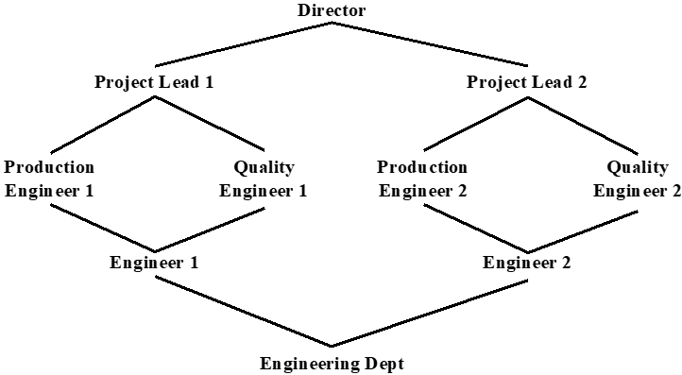
Example of Role Hierarchy
A line between two roles implies that the upper role includes all of the access rights of the lower role, as well as other access rights not available to the lower role.
One role can inherit access rights from multiple subordinate roles, e.g., the Project Lead role includes all of the access rights of the Production Engineer role and of the Quality Engineer role.

Slide 24
Constraints
A defined relationship among roles or a condition related to roles
Mutually exclusive roles
  A user can only be assigned to one role in the set (either during a session or statically),
    e.g., the set (student, teacher) is mutually exclusive; the set (student, TA, teacher) is not mutually exclusive (if a student may work as a TA).
  Any permission (access right) can be granted to only one role in the set
Cardinality
  Setting a maximum number of users that can be assigned to a given role, or the maximum number of roles that a user is assigned to, or a user can activate in a single session
Prerequisite roles
  Dictates that a user can only be assigned to a particular role if it is already assigned to some other specified role (used with role hierarchies)
Notes:
Constraints provide a means of adapting RBAC to the
specifics of administrative and security policies in an organization. A constraint is
a defined relationship among roles or a condition related to roles. [SAND96] lists
the following types of constraints: mutually exclusive roles, cardinality, and prerequisite
roles.
Mutually exclusive roles are roles such that a user can be assigned to only
one role in the set. This limitation could be a static one, or it could be dynamic, in
the sense that a user could be assigned only one of the roles in the set for a session.
The mutually exclusive constraint supports a separation of duties and capabilities
within an organization. This separation can be reinforced or enhanced by use of
mutually exclusive permission assignments. With this additional constraint, a mutually
exclusive set of roles has the following properties:
1. A user can only be assigned to one role in the set (either during a session or
statically).
2. Any permission (access right) can be granted to only one role in the set.
Thus the set of mutually exclusive roles have non-overlapping permissions. If two
users are assigned to different roles in the set, then the users have non-overlapping
permissions while assuming those roles. The purpose of mutually exclusive roles is to
increase the difficulty of collusion among individuals of different skills or divergent job
functions to thwart security policies.
Cardinality refers to setting a maximum number with respect to roles. One
such constraint is to set a maximum number of users that can be assigned to a given
role. For example, a project leader role or a department head role might be limited
to a single user. The system could also impose a constraint on the number of roles
that a user is assigned to, or the number of roles a user can activate for a single session.
Another form of constraint is to set a maximum number of roles that can be
granted a particular permission; this might be a desirable risk mitigation technique
for a sensitive or powerful permission.
A system might be able to specify a prerequisite, which dictates that a user can
only be assigned to a particular role if it is already assigned to some other specified
role. A prerequisite can be used to structure the implementation of the least privilege
concept. In a hierarchy, it might be required that a user can be assigned to a senior
(higher) role only if it is already assigned an immediately junior (lower) role. For
example, in Figure 4.9 a user assigned to a Project Lead role must also be assigned
to the subordinate Production Engineer and Quality Engineer roles. Then, if the user
does not need all of the permissions of the Project Lead role for a given task, the user
can invoke a session using only the required subordinate role. Note that the use of
prerequisites tied to the concept of hierarchy requires the RBAC₃ model.

Slide 25
Outline
Introduction
Discretionary Access Control (DAC)
  UNIX file access control
Role-based Access Control (RBAC)
Attribute-Based Access Control (ABAC)
Bank RBAC system

Slide 26
Attribute-Based Access Control (ABAC)
Can define authorizations that express conditions on properties of both the resource and the subject
Strength is its flexibility and expressive power
Main obstacle to its adoption in real systems is slow performance of evaluating predicates on both resource and user properties for each access
There is considerable interest in applying the model to web services.
Notes:
Web services have been pioneering technologies through the introduction of the eXtensible Access Control Markup Language (XAMCL)
A relatively recent development in access control technology is the attribute-based
access control (ABAC) model. An ABAC model can define authorizations that
express conditions on properties of both the resource and the subject. For example,
consider a configuration in which each resource has an attribute that identifies the
subject that created the resource. Then, a single access rule can specify the ownership
privilege for all the creators of every resource. The strength of the ABAC
approach is its flexibility and expressive power. [PLAT13] points out that the main
obstacle to its adoption in real systems has been concern about the performance
impact
of evaluating predicates on both resource and user properties for each
access. However, for applications such as cooperating Web services and cloud computing,
this increased performance cost is less noticeable because there is already a
relatively high performance cost for each access. Thus, Web services have been pioneering
technologies for implementing ABAC models, especially through the introduction
of the eXtensible Access Control Markup Language (XAMCL) [BEUC13],
and there is considerable interest in applying the ABAC model to cloud services
[IQBA12, YANG12].
There are three key elements to an ABAC model: attributes, which are defined
for entities in a configuration; a policy model, which defines the ABAC policies; and
the architecture model, which applies to policies that enforce access control. We
examine these elements in turn.

Slide 27
ABAC Model: Attributes
Subject attributes
  Define identity and characteristics of the subject
Object attributes
  Define identity and characteristics of the object
Environment attributes
  Describe the operational, technical, and situational environment or context in which the information access occurs
  e.g., a stock brokerage system may specify that transactions are permitted only during workdays 9am–5pm, so time is part of env attributes
Notes:
A subject is an active entity that causes information to flow among objects or changes the system state
Attributes are characteristics that define specific aspects of the subject, object, environment
conditions, and/or requested operations that are predefined and preassigned
by an authority. Attributes contain information that indicates the class of information
given by the attribute, a name, and a value (e.g., Class=HospitalRecordsAccess,
Name=PatientInformationAccess, Value=MFBusinessHoursOnly).
The following are the three types of attributes in the ABAC model:
• Subject attributes: A subject is an active entity (e.g., a user, an application, a
process, or a device) that causes information to flow among objects or changes
the system state. Each subject has associated attributes that define the identity
and characteristics of the subject. Such attributes may include the subject’s
identifier, name, organization, job title, and so on. A subject’s role can also be
viewed as an attribute.
• Object attributes: An object, also referred to as a resource , is a passive (in the
context of the given request) information system-related entity (e.g., devices,
files, records, tables, processes, programs, networks, domains) containing or
receiving information. As with subjects, objects have attributes that can be
leveraged to make access control decisions. A Microsoft Word document, for
example, may have attributes such as title, subject, date, and author. Object
attributes can often be extracted from the metadata of the object. In particular,
a variety of Web service metadata attributes may be relevant for access
control purposes, such as ownership, service taxonomy, or even Quality of
Service (QoS) attributes.
• Environment attributes: These attributes have so far been largely ignored in
most access control policies. They describe the operational, technical, and even
situational environment or context in which the information access occurs. For
example, attributes, such as current date and time, the current virus/hacker
activities, and the network’s security level (e.g., Internet vs. intranet), are not
associated with a particular subject nor a resource, but may nonetheless be
relevant in applying an access control policy.

Slide 28
ABAC
Controls access to objects by evaluating rules against the attributes of entities, operations, and the environment relevant to a request.
Allows an unlimited number of attributes to be combined to satisfy any access control rule.
Most general. ABAC can be used to implement DAC, MAC and RBAC
Notes:
Relies upon the evaluation of attributes of the subject and the object, and access control rule defining the allowable operations for subject-object attribute combinations in a given environment.
ABAC is a logical access control model that is distinguishable because it controls
access to objects by evaluating rules against the attributes of entities (subject
and object), operations, and the environment relevant to a request. ABAC relies
upon the evaluation of attributes of the subject, attributes of the object, and a formal
relationship or access control rule defining the allowable operations for subjectobject
attribute combinations in a given environment. All ABAC solutions contain
these basic core capabilities to evaluate attributes and enforce rules or relationships
between those attributes. ABAC systems are capable of enforcing DAC, RBAC,
and MAC concepts. ABAC enables fine-grained access control, which allows for a
higher number of discrete inputs into an access control decision, providing a bigger
set of possible combinations of those variables to reflect a larger and more definitive
set of possible rules, policies, or restrictions on access. Thus, ABAC allows an
unlimited number of attributes to be combined to satisfy any access control rule.
Moreover, ABAC systems can be implemented to satisfy a wide array of requirements
from basic access control lists through advanced expressive policy models
that fully leverage the flexibility of ABAC.

Slide 29
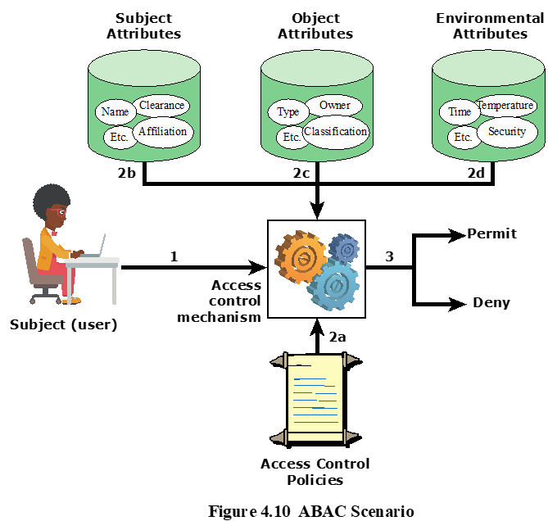
ABAC Scenario
  ABAC allows very flexible policies to be specified, e.g. only users with affiliation of ZJU, security clearance of high, age older than 40 can access files with owner ZJU, classification “secret” or below, during workdays 9am-5pm.
29
Notes:
Figure 4.10 illustrates in a logical architecture the essential components of an ABAC
system. An access by a subject to an object proceeds according to the following steps:
1. A subject requests access to an object. This request is routed to an access control
mechanism.
2. The access control mechanism is governed by a set of rules (2a) that are defined
by a preconfigured access control policy. Based on these rules, the access control
mechanism assesses the attributes of the subject (2b), object (2c), and current
environmental conditions (2d) to determine authorization.
3. The access control mechanism grants the subject access to the object if access
is authorized and denies access if it is not authorized.
It is clear from the logical architecture that there are four independent sources
of information used for the access control decision. The system designer can decide
which attributes are important for access control with respect to subjects, objects,
and environmental conditions. The system designer or other authority can then
define access control policies, in the form of rules, for any desired combination of
attributes of subject, object, and environmental conditions. It should be evident that
this approach is very powerful and flexible. However, the cost, both in terms of
the complexity of the design and implementation and in terms of the performance
impact, is likely to exceed that of other access control approaches. This is a tradeoff
that the system authority must make.

Slide 30
ABAC Policies
A policy is a set of rules and relationships that govern allowable behavior within an organization, based on the privileges of subjects and how resources or objects are to be protected under which environment conditions
Typically written from the perspective of the object that needs protecting and the privileges available to subjects (similar to ACL)
Notes:
A policy is a set of rules and relationships that govern allowable behavior within an
organization, based on the privileges of subjects and how resources or objects are to
be protected under which environment conditions. In turn, privileges represent the
authorized behavior of a subject; they are defined by an authority and embodied in
a policy. Other terms that are commonly used instead of privileges are rights , authorizations ,
and entitlements . Policy is typically written from the perspective of the
object that needs protecting and the privileges available to subjects.

Slide 31
RBAC vs ABAC
RBAC is simpler and more efficient at runtime
RBAC is for coarse-grained access control; ABAC is for fine-grained access control
  e.g., RBAC can be used to give all teachers (not students) access to a database; ABAC can be used to give teachers access to a database if they are at School X and teach Grade Y, during 9am to 5pm workdays
RBAC and ABAC can be used together hierarchally
  e.g., RBAC controls who can see what modules; ABAC controls access to what a user can see (or can do) inside of a module.

Slide 32
Outline
Introduction
Discretionary Access Control (DAC)
  UNIX file access control
Role-based Access Control (RBAC)
Attribute-Based Access Control (ABAC)
Bank RBAC system

Slide 33
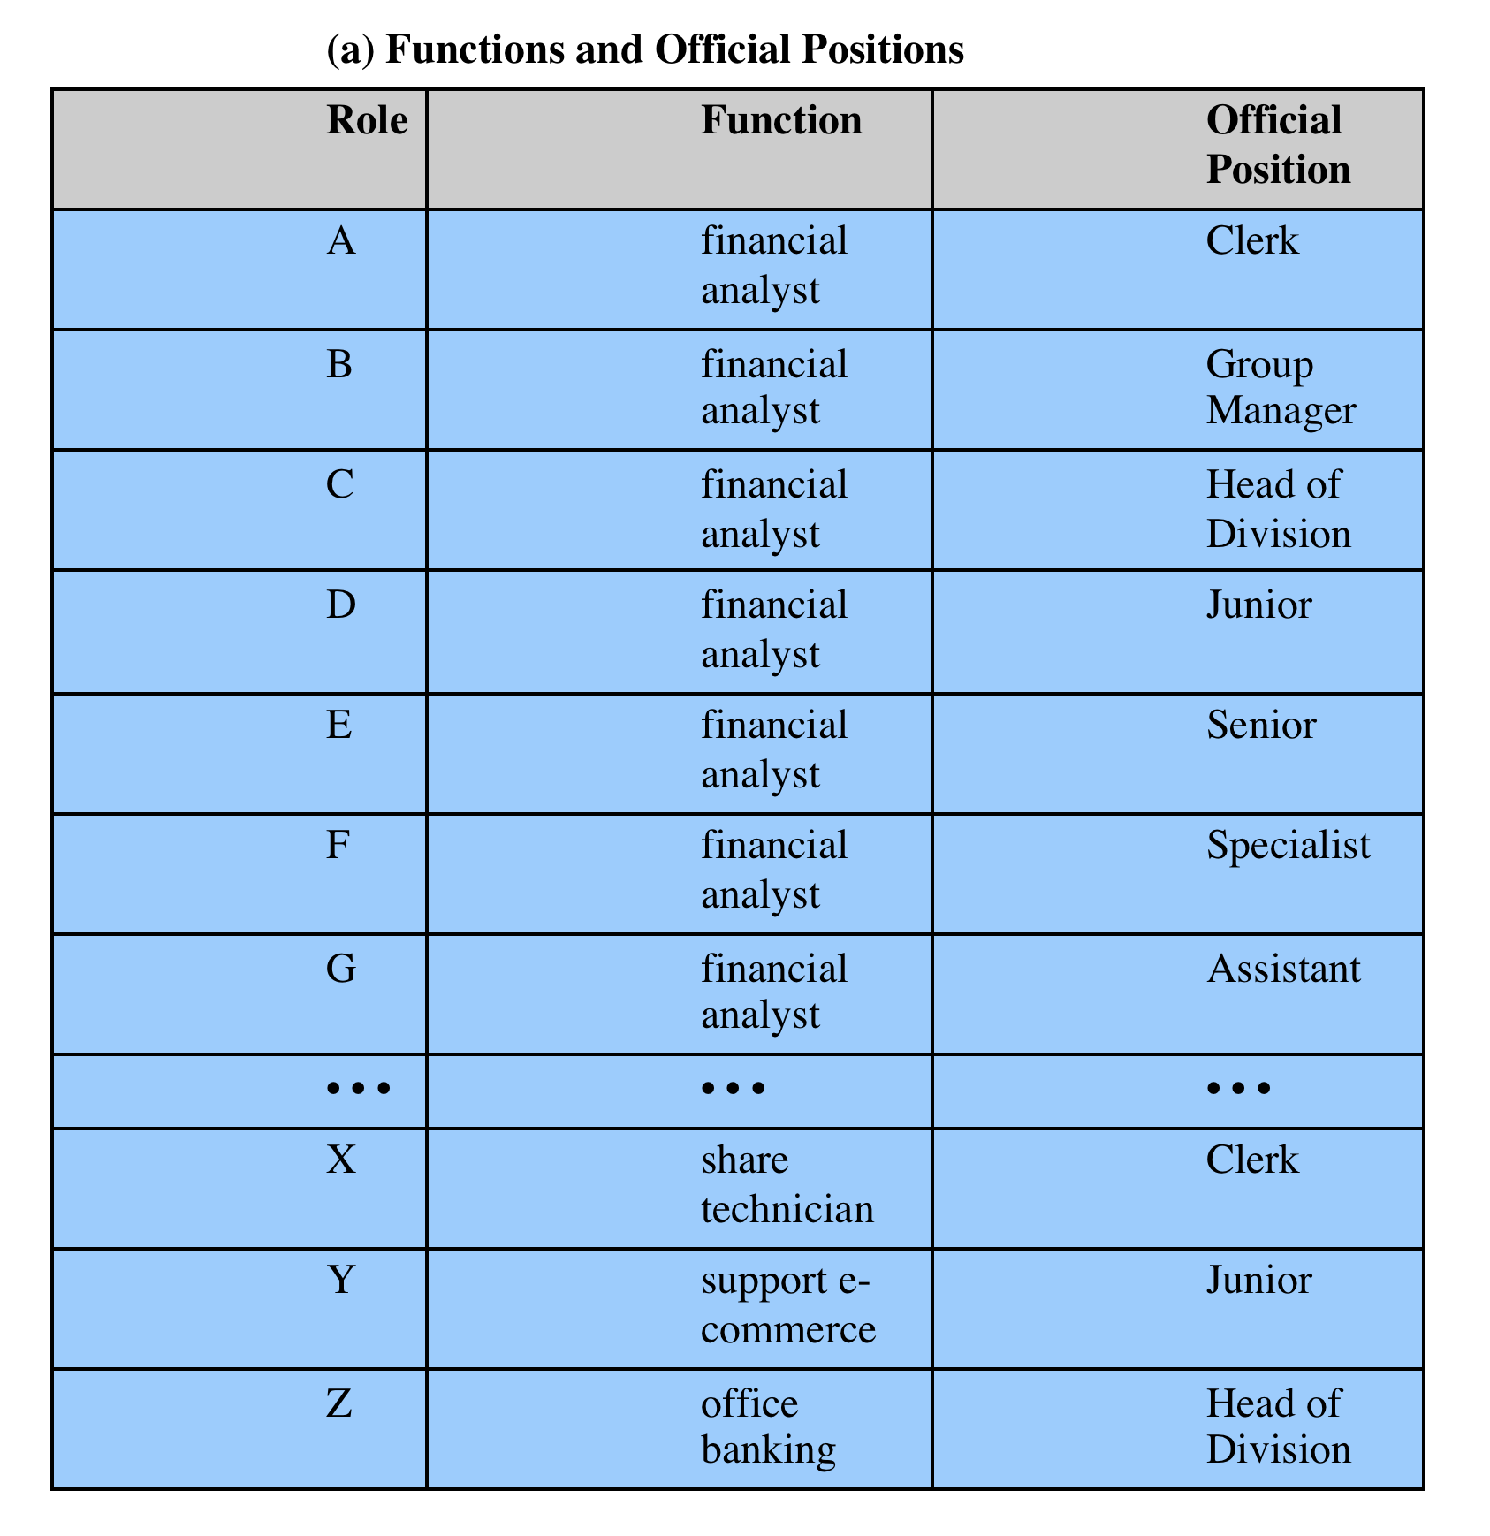
Case Study: RBAC System For A Bank
Each role is defined by an official position performing a function.
Notes:
the positions Head of Division, Group Manager, and Clerk are in descending order. When the official position is combined with job function, there is a resulting ordering of access rights. The Role Hierarchy consists of the positions Head of Division, Group Manager, and Clerk are in descending order. When the official position is combined with job function, there is a resulting ordering of access rights.

Slide 34
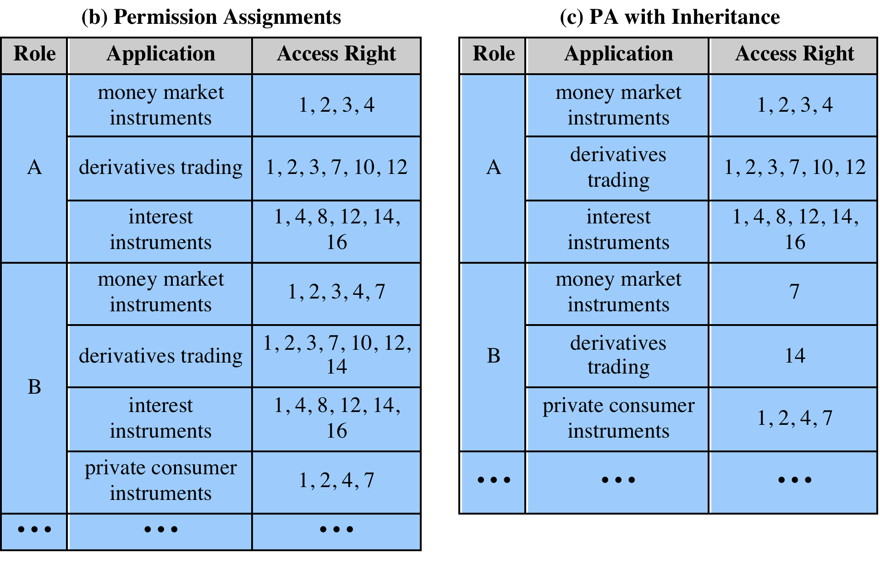
Functions and Roles
Notes:
Within the bank, there is a strict partial ordering of
official positions within each organization, reflecting a hierarchy of responsibility
and power. For example, the positions Head of Division, Group Manager, and
Clerk are in descending order. When the official position is combined with job function,
there is a resulting ordering of access rights, as indicated in Table 4.4b. Thus,
the financial analyst/Group Manager role (role B) has more access
rights than the financial analyst/Clerk role (role A). The table indicates that role B has as many or
more access rights than role A in three applications and has access rights to a fourth
application. On the other hand, there is no hierarchical relationship between
Office banking/Group Manager and financial analyst/Clerk because they work in different
functional areas. We can therefore define a role hierarchy in which one role is superior
to another if its position is superior and their functions are identical. The role
hierarchy makes it possible to economize on access
rights definitions, as suggested in Table 4.5c.

Slide 35
Functions and Roles Explanations
Role B has more access rights than Role A.
  Role B has as many or more access rights than role A in three applications and has access rights to a fourth application.
We can define a role hierarchy in which Role B is superior to Role A, making it possible to simplify access rights definitions, as in (c).
Notes:
On the other hand, there is no hierarchical relationship between Office banking/Group Manager and financial analyst/Clerk because they work in different functional areas.
, since if its position is superior and their functions are identical

Slide 36
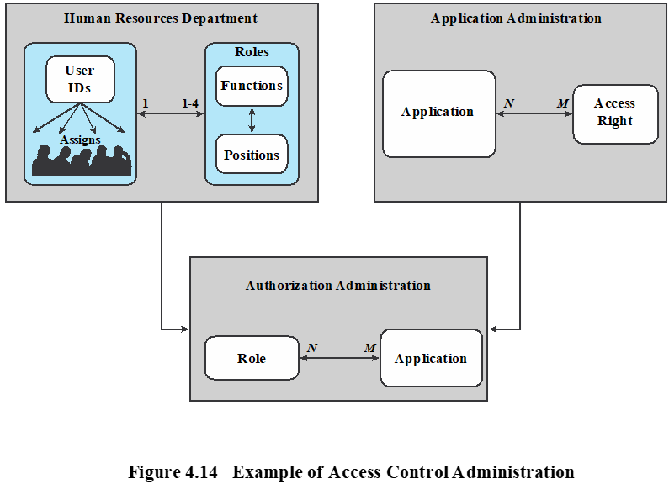
Access Control Administration
Each user may be statically assigned 1-4 roles (constraint) by the HR Department, and selects a given role for use in invoking a particular application.
The user/role information is provided to the Authorization Administration, which creates a security profile for each user that associates the User ID and role with a set of access rights.
When a user invokes an application, the application consults the security profile for that user to determine what subset of the application’s access rights are in force for this user in this role.
Notes:
In the original scheme, the direct assignment of access rights to the individual
user occurred at the application level and was associated with the individual
application. In the new scheme, an application administration determines the set of access rights associated
with each individual application. However, a given user performing a given task
may not be permitted all of the access rights associated with the application. When a
user invokes an application, the application grants access on the basis of a centrally provided
security profile. A separate authorization administration associated access rights
with roles and creates the security profile for a use on the basis of the user’s role.
A user is statically assigned a role. In principle (in this example), each user
may be statically assigned up to four roles and select a given role for use in invoking
a particular application. This corresponds to the NIST concept of session. In practice,
most users are statically assigned a single role based on the user’s position and
job function.
All of these ingredients are depicted in Figure 4.14. The Human Resource
Department assigns a unique User ID to each employee who will be using the system.
Based on the user’s position and job function, the department
also assigns one or more roles to the user. The user/role information is provided to the Authorization
Administration, which creates a security profile for each user that associates the
User ID and role with a set of access rights. When a user invokes an application,
the application consults the security profile for that user to determine what subset of
the application’s access rights are in force for this user in this role.
A role may be used to access several applications. Thus, the set of access
rights associated with a role may include access rights that are not associated with one
of the applications the user invokes. This is illustrated in Table 4.4b. Role A has
numerous access rights, but only a subset of those rights are applicable to each of the
three applications that role A may invoke.
Some figures about this system are of interest. Within the bank, there are 65
official positions, ranging from a Clerk in a branch, through the Branch Manager,
to a Member of the Board. These positions are combined with 368 different job
functions provided by the human resources database. Potentially, there are 23,920
different roles, but the number of roles in current use is about 1,300. This is in line
with the experience other RBAC implementations. On average, 42,000 security
profiles are distributed to applications each day by the Authorization Administration
module.

