Slide 1
CH09 Firewalls and Intrusion Prevention
Zonghua Gu
2017, ZJU
Notes:
This chapter provides an overview of computer security. We begin with a discussion
of what we mean by computer security. In essence, computer security deals
with computer-related assets that are subject to a variety of threats and for which
various measures are taken to protect those assets. Accordingly, the next section of
this chapter provides a brief overview of the categories of computer-related assets
that users and system managers wish to preserve and protect, and a look at the
various threats and attacks that can be made on those assets. Then, we survey the
measures that can be taken to deal with such threats and attacks. This we do from
three different viewpoints, in Sections 1.3 through 1.5. We then lay out in general
terms a computer security strategy.
The focus of this chapter, and indeed this book, is on three fundamental
questions:
1. What assets do we need to protect?
2. How are those assets threatened?
3. What can we do to counter those threats?

Slide 2
Outline
Introduction
Types of firewalls
  Packet filtering firewall
  Stateful inspection firewalls
  Application-level gateway
Firewall basing
  Bastion host
  Host-based firewalls
  Personal firewall
Firewall location and configurations
  DMZ networks
  VPNs
  Distributed firewalls
Intrusion prevention systems
  Host-based IPS
  Network-based IPS
  Snort inline
Unified Threat Management Products

Slide 3
Firewalls
Effective means of protecting LANs
Inserted between the premises network and the Internet to establish a controlled link
Used as a perimeter defense
  Single choke point that insulates the internal systems from external networks
  Only authorized traffic as defined by the local security policy will be allowed to pass
Direction
  Ingress: for incoming traffic
    Block outside users from accessing certain intranet computers
  Egress: for outgoing traffic
    Block inside users from accessing certain outside websites like Facebook
Notes:
Security policy: defines authorized traffic that can pass pass through the firewall
Design goals
All traffic from inside to outside, and vice versa, must pass through the firewall
The firewall itself is immune to penetration
Internet connectivity is no longer optional for organizations. The information
and services available are essential to the organization. Moreover, individual users
within the organization want and need Internet access, and if this is not provided
via their LAN, they could use a wireless broadband capability from their PC to an
Internet service provider (ISP). However, while Internet access provides benefits to
the organization, it enables the outside world to reach and interact with local network
assets. This creates a threat to the organization. While it is possible to equip
each workstation and server on the premises network with strong security features,
such as intrusion protection, this may not be sufficient and in some cases is not cost effective.
Consider a network with hundreds or even thousands of systems, running
various operating systems, such as different versions of Windows, MacOSX, and
Linux. When a security flaw is discovered, each potentially affected system must be
upgraded to fix that flaw. This requires scaleable configuration management and
aggressive patching to function effectively. While difficult, this is possible and is necessary
if only host-based security is used. A widely accepted alternative or at least
complement to host-based security services is the firewall. The firewall is inserted
between the premises network and the Internet to establish a controlled link and to
erect an outer security wall or perimeter. The aim of this perimeter is to protect the
premises network from Internet-based attacks and to provide a single choke point
where security and auditing can be imposed. The firewall may be a single computer
system or a set of two or more systems that cooperate to perform the firewall function.
The firewall, then, provides an additional layer of defense, insulating the internal
systems from external networks. This follows the classic military doctrine of
“defense in depth,” which is just as applicable to IT security.
[BELL94] lists the following design goals for a firewall:
1. All traffic from inside to outside, and vice versa, must pass through the firewall.
This is achieved by physically blocking all access to the local network except via
the firewall. Various configurations are possible, as explained later in this chapter.
2. Only authorized traffic, as defined by the local security policy, will be allowed
to pass. Various types of firewalls are used, which implement various types of
security policies, as explained later in this chapter.
3. The firewall itself is immune to penetration. This implies the use of a hardened
system with a secured operating system. Trusted computer systems are
suitable for hosting a firewall and often required in government applications.
This topic is discussed in Chapter 13 .

Slide 4
Firewall Access Policy
A critical component in the planning and implementation of a firewall is specifying a suitable access policy
  This lists the types of traffic authorized to pass through the firewall
  Includes IP address ranges, protocols, applications and content types
This policy should be developed from the organization’s information security risk assessment and policy, and which traffic types the organization needs to support
Notes:
A critical component in the planning and implementation of a firewall is
specifying a suitable access policy. This lists the types of traffic authorized to pass
through the firewall, including address ranges, protocols, applications and content
types. This policy should be developed from the organization’s information security
risk assessment and policy, that we discuss in Chapters 14 and 15. This policy
should be developed from a broad specification of which traffic types the organization
needs to support. It is then refined to detail the filter elements we discuss next,
which can then be implemented within an appropriate firewall topology.

Slide 5
Firewall Filter Characteristics
IP address and protocol values
  Used by packet filter and stateful inspection firewalls to limit access to specific services
Application protocol
  Used by an application-level gateway that relays and monitors the exchange of information for specific applications, e.g., checking SMTP email for spam
User identity
  Controls access based on user identity, for users who identify themselves using some form of secure authentication (IPSec)
Network activity
  Controls access based on considerations such as the time of request, e.g., only in business hours; rate of requests, e.g., to detect scanning attempts.
Notes:
[SCAR09b] lists a range of characteristics that a firewall access policy could
use to filter traffic, including:
• IP Address and Protocol Values: Controls access based on the source or
destination addresses and port numbers, direction of flow being inbound or
outbound, and other network and transport layer characteristics. This type of
filtering is used by packet filter and stateful inspection firewalls. It is typically
used to limit access to specific services.
• Application Protocol: Controls access on the basis of authorized application
protocol data. This type of filtering is used by an application-level gateway
that relays and monitors the exchange of information for specific application
protocols, e.g., checking SMTP email for spam, or HTPP web requests to
authorized sites only.
• User Identity: Controls access based on the users identity, typically for inside
users who identify themselves using some form of secure authentication technology,
such as IPSec (Chapter 22).
• Network Activity: Controls access based on considerations such as the time or
request, e.g., only in business hours; rate of requests, e.g., to detect scanning
attempts; or other activity patterns.

Slide 6
Firewall Capabilities And Limits
Capabilities:
  Defines a single choke point
  Provides a location for monitoring security events
  Can serve as the platform for IPSec
Limitations:
  Cannot protect against attacks bypassing firewall
  May not protect against internal threats
  Improperly secured wireless LAN can be accessed from outside the organization
  Mobile devices may be infected outside the corporate network then used internally
Notes:
Convenient platform for several Internet functions that are not security related, e.g., Network Address Translation (NAT).
Before proceeding to the details of firewall types and configurations, it is best
to summarize what one can expect from a firewall. The following capabilities are
within the scope of a firewall:
1. A firewall defines a single choke point that attempts to keep unauthorized
users out of the protected network, prohibit potentially vulnerable services
from entering or leaving the network, and provide protection from various
kinds of IP spoofing and routing attacks. The use of a single choke point
simplifies security management because security capabilities are consolidated
on a single system or set of systems.
2. A firewall provides a location for monitoring security-related events. Audits
and alarms can be implemented on the firewall system.
3. A firewall is a convenient platform for several Internet functions that are not
security related. These include a network address translator, which maps local
addresses to Internet addresses, and a network management function that
audits or logs Internet usage.
4. A firewall can serve as the platform for IPSec. Using the tunnel mode capability
described in Chapter 22 , the firewall can be used to implement virtual
private networks.
Firewalls have their limitations, including the following:
1. The firewall cannot protect against attacks that bypass the firewall. Internal
systems may have dial-out or mobile broadband capability to connect to
an ISP. An internal LAN may support a modem pool that provides dial-in
capability for traveling employees and telecommuters.
2. The firewall may not protect fully against internal threats, such as a disgruntled
employee or an employee who unwittingly cooperates with an external
attacker.
3. An improperly secured wireless LAN may be accessed from outside the
organization. An internal firewall that separates portions of an enterprise
network cannot guard against wireless communications between local systems
on different sides of the internal firewall.
4. A laptop, PDA, or portable storage device may be used and infected outside
the corporate network and then attached and used internally.

Slide 7
Outline
Introduction
Types of firewalls
  Packet filtering firewall
  Stateful inspection firewalls
  Application-level gateway
Firewall basing
  Bastion host
  Host-based firewalls
  Personal firewall
Firewall location and configurations
  DMZ networks
  VPNs
  Distributed firewalls
Intrusion prevention systems
  Host-based IPS
  Network-based IPS
  Snort inline
Unified Threat Management Products

Slide 8
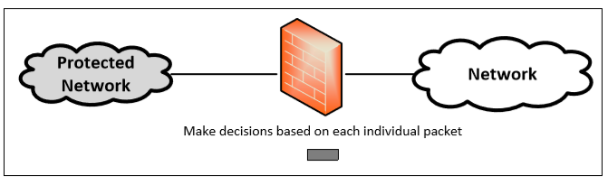
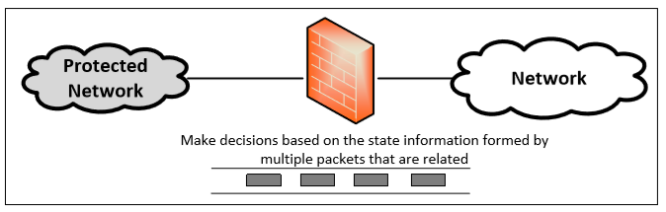
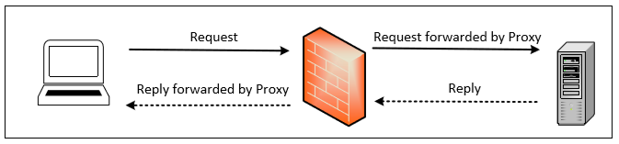
Types of Firewalls
Packet Filtering Firewall
Stateful Firewall
Application Proxy

Slide 9
Packet Filtering Firewall
Applies rules to each incoming and outgoing IP packet to decide to forward or discard it
Two default policies:
  Discard - prohibit unless expressly permitted
    More conservative, controlled, visible to users
  Forward - permit unless expressly prohibited
    Easier to manage and use but less secure
Filtering rules are based on information contained in a network packet
Source IP address
Destination IP address
Source and destination transport-level address
IP protocol info
Which interface of the firewall the packet comes from or is destined for
Notes:
A packet filtering firewall applies a set of rules to each incoming and outgoing
IP packet and then forwards or discards the packet ( Figure 9.1b ). The firewall
is typically configured to filter packets going in both directions (from and to
the internal network). Filtering rules are based on information contained in a
network packet:
• Source IP address: The IP address of the system that originated the IP packet
(e.g., 192.178.1.1)
• Destination IP address: The IP address of the system the IP packet is trying to
reach (e.g., 192.168.1.2)
• Source and destination transport-level address: The transport-level (e.g., TCP
or UDP) port number, which defines applications such as SNMP or TELNET
• IP protocol field: Defines the transport protocol
• Interface: For a firewall with three or more ports, which interface of the firewall
the packet came from or which interface of the firewall the packet is destined for
The packet filter is typically set up as a list of rules based on matches to fields
in the IP or TCP header. If there is a match to one of the rules, that rule is invoked
to determine whether to forward or discard the packet. If there is no match to any
rule, then a default action is taken. Two default policies are possible:
• Default = discard: That which is not expressly permitted is prohibited.
• Default = forward: That which is not expressly prohibited is permitted.
The default discard policy is more conservative. Initially, everything is blocked,
and services must be added on a case-by-case basis. This policy is more visible to
users, who are more likely to see the firewall as a hindrance. However, this is the
policy likely to be preferred by businesses and government organizations. Further,
visibility to users diminishes as rules are created. The default forward policy increases
ease of use for end users but provides reduced security; the security administrator
must, in essence, react to each new security threat as it becomes known. This policy
may be used by generally more open organizations, such as universities.

Slide 10
TCP & SMTP
Port numbers lower than 1024 are assigned permanently to particular applications (e.g., 25 for server SMTP). Port numbers between 1024 and 65535 are generated dynamically and have temporary significance only for the lifetime of a TCP connection.
When a TCP client creates a session with a remote host, it creates a TCP connection in which the TCP port number for the remote (server) application is a number less than 1024 and the TCP port number for the local (client) application is a number between 1024 and 65535.
  A simple packet filtering firewall must permit inbound network traffic on all these high-numbered ports for TCP-based traffic to occur. This creates a vulnerability that can be exploited by unauthorized users.
Simple Mail Transfer Protocol (SMTP)
  SMTP operates by setting up a TCP connection between client and server for sending emails. The SMTP server’s TCP port number is 25; The SMTP client’s TCP port number is any number between 1024 and 65535 that is generated dynamically by the SMTP client, and only valid during the email session.

Slide 11
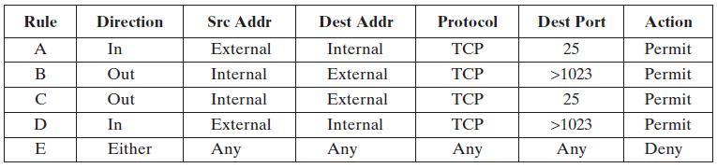
Packet-Filtering Rules Example
This firewall only allows SMTP traffic through it (inbound or outbound).
Rules A and B allow incoming email:
  A. Allow inbound SMTP connection to local SMTP server: Inbound TCP packets from an external source to port 25.
  B. Allow outbound response to inbound SMTP connection: TCP packets to a destination port above 1023.
Rules C and D allow outgoing email:
  C. Allow outbound SMTP connection to remote SMTP server: Outbound TCP packets from an internal source to port 25.
  D. Allow inbound response to outbound SMTP connection: Inbound TCP packets to a destination port above 1023.
Rule E. Any packets that do not match rules A-D are disallowed.
Notes:
Table 9.1 is a simplified example of a rule set for SMTP traffic. The goal is to
allow inbound and outbound email traffic but to block all other traffic. The rules are
applied top to bottom to each packet. The intent of each rule is:
1. Inbound mail from an external source is allowed (port 25 is for SMTP incoming).
2. This rule is intended to allow a response to an inbound SMTP connection.
3. Outbound mail to an external source is allowed.
4. This rule is intended to allow a response to an inbound SMTP connection.
5. This is an explicit statement of the default policy. All rule sets include this rule
implicitly as the last rule.
There are several problems with this rule set. Rule 4 allows external traffic
to any destination port above 1023. As an example of an exploit of this rule, an
external attacker can open a connection from the attacker’s port 5150 to an internal
Web proxy server on port 8080. This is supposed to be forbidden and could allow an
attack on the server. To counter this attack, the firewall rule set can be configured
with a source port field for each row. For rules 2 and 4, the source port is set to 25;
for rules 1 and 3, the source port is set to >1023.

Slide 12
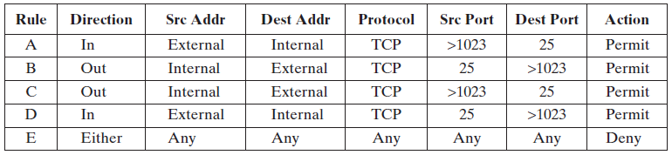
Possible Attacks
The original Rule D allows inbound traffic to any destination port above 1023. An external attacker can open a connection from his port 5150 to an internal Web proxy server on port 8080 to attack the server.
To counter this attack, the firewall rule set can be configured with a source port field for each row. For rules B and D, the source port is set to 25; for rules A and C, the source port is set to >1023.
This assumes the attacker cannot send attack packets from Port 25. Is it true?

Slide 13

Adding ACK Flag
Using port 25 for SMTP receipt is only a default; the attacker’s machine could be configured to have some other application linked to port 25 and send attack packets from it.
To counter this threat, we can add an ACK flag field to each row. For rule 4, the field would indicate that the ACK flag must be set on the incoming packet with a source port number of 25.
The rule takes advantage of a feature of TCP connections. Once a connection is set up, the ACK flag of a TCP segment is set to acknowledge segments sent from the other side.
Notes:
But a vulnerability remains. Rules 3 and 4 are intended to specify that any
inside host can send mail to the outside. A TCP packet with a destination port of
25 is routed to the SMTP server on the destination machine. The problem with this
rule is that the use of port 25 for SMTP receipt is only a default; an outside machine
could be configured to have some other application linked to port 25. As the revised
rule 4 is written, an attacker could gain access to internal machines by sending packets
with a TCP source port number of 25. To counter this threat, we can add an
ACK flag field to each row. For rule 4, the field would indicate that the ACK flag
must be set on the incoming packet.
The rule takes advantage of a feature of TCP connections. Once a connection
is set up, the ACK flag of a TCP segment is set to acknowledge segments sent from
the other side. Thus, this rule allows incoming packets with a source port number of
25 that include the ACK flag in the TCP segment.
To counter this attack, we can add an ACK flag field to Rule D, indicating that the ACK flag must be set on the incoming packet to ensure that the inbound packet is in response to an earlier outbound packet, not originating from the outside.
The rule takes advantage of a feature of TCP: Once a connection is set up, the ACK flag of a TCP segment is set to acknowledge segments sent from the other side

Slide 14
Packet Filter
Advantages And Weaknesses
Advantages
  Simple and efficient
  Transparent to users
Weaknesses
  Cannot prevent attacks that employ application-level vulnerabilities, e.g., SQL injection attacks
    e.g., cannot block specific application commands; if a packet filter firewall allows a given application, all functions available within that application will be permitted.
  Limited logging functionality
    Only source address, destination address, and traffic type.
  Do not support advanced user authentication
    Due to the lack of upper-layer functionality
  Vulnerable to attacks on TCP/IP protocol bugs, e.g., IP address spoofing
  Improper configuration of firewall policy can lead to breaches
Notes:
One advantage of a packet filtering firewall is its simplicity. Also, packet filters
typically are transparent to users and are very fast. [SCAR09b] lists the following
weaknesses of packet filter firewalls:
• Because packet filter firewalls do not examine upper-layer data, they cannot
prevent attacks that employ application-specific vulnerabilities or functions.
For example, a packet filter firewall cannot block specific application
commands; if a packet filter firewall allows a given application, all functions
available within that application will be permitted.
• Because of the limited information available to the firewall, the logging
functionality present in packet filter firewalls is limited. Packet filter logs
normally contain the same information used to make access control decisions
(source address, destination address, and traffic type).
• Most packet filter firewalls do not support advanced user authentication
schemes. Once again, this limitation is mostly due to the lack of upper-layer
functionality by the firewall.
• Packet filter firewalls are generally vulnerable to attacks and exploits that take
advantage of problems within the TCP/IP specification and protocol stack,
such as network layer address spoofing . Many packet filter firewalls cannot
detect a network packet in which the OSI Layer 3 addressing information has
been altered. Spoofing attacks are generally employed by intruders to bypass
the security controls implemented in a firewall platform.
• Finally, due to the small number of variables used in access control decisions,
packet filter firewalls are susceptible to security breaches caused by improper
configurations. In other words, it is easy to accidentally configure a packet
filter firewall to allow traffic types, sources, and destinations that should be
denied based on an organization’s information security policy.
Some of the attacks that can be made on packet filtering firewalls and the
appropriate countermeasures are the following:
• IP address spoofing : The intruder transmits packets from the outside with a
source IP address field containing an address of an internal host. The attacker
hopes that the use of a spoofed address will allow penetration of systems that
employ simple source address security, in which packets from specific trusted
internal hosts are accepted. The countermeasure is to discard packets with an
inside source address if the packet arrives on an external interface. In fact, this
countermeasure is often implemented at the router external to the firewall.
• Source routing attacks: The source station specifies the route that a packet
should take as it crosses the Internet, in the hopes that this will bypass security
measures that do not analyze the source routing information. A countermeasure
is to discard all packets that use this option.
• Tiny fragment attacks : The intruder uses the IP fragmentation option to create
extremely small fragments and force the TCP header information into
a separate packet fragment. This attack is designed to circumvent filtering
rules that depend on TCP header information. Typically, a packet filter
will make a filtering decision on the first fragment of a packet. All subsequent
fragments of that packet are filtered out solely on the basis that
they are part of the packet whose first fragment was rejected. The attacker
hopes that the filtering firewall examines only the first fragment and that
the remaining fragments are passed through. A tiny fragment attack can be
defeated by enforcing a rule that the first fragment of a packet must contain
a predefined minimum amount of the transport header. If the first fragment
is rejected, the filter can remember the packet and discard all subsequent
fragments.

Slide 15
Packet Filter
Attacks and Countermeasures
IP address spoofing
  Intruder transmits packets from the outside with a source IP address field containing an address of an internal host to attack systems that employ simple source address security, in which packets from trusted internal hosts are accepted.
  Countermeasure is to discard packets with an inside source address if the packet arrives on an external interface.
Source routing attack
  Source routing allows a sender of a packet to partially or completely specify the route the packet takes through the network. In contrast, in non-source routing protocols, routers in the network determine the path based on the packet's destination. This can be used to bypass certain security measures on routers that do not analyze the source routing information.
  Countermeasure is to discard all packets that use this option.
Tiny fragment attack
  Intruder uses the IP fragmentation option to create extremely small fragments and force the TCP header information into a separate packet fragment, in order to circumvent filtering rules that depend on TCP header information (port numbers). The attacker hopes that the filtering firewall examines only the first fragment (IP addresses without port numbers) and that the remaining fragments are passed through.
  Countermeasure is to enforce a rule that the first fragment of a packet must contain a minimum amount of the TCP header. If the first fragment is rejected, the filter can remember the packet and discard all subsequent fragments.
Fragmentation
Frag 1
Frag 2
Frag 3
Frag 4…
IP Header
TCP Header
Payload
IP Header
TCP Header
Payload
Notes:
Some of the attacks that can be made on packet filtering firewalls and the
appropriate countermeasures are the following:
• IP address spoofing : The intruder transmits packets from the outside with a
source IP address field containing an address of an internal host. The attacker
hopes that the use of a spoofed address will allow penetration of systems that
employ simple source address security, in which packets from specific trusted
internal hosts are accepted. The countermeasure is to discard packets with an
inside source address if the packet arrives on an external interface. In fact, this
countermeasure is often implemented at the router external to the firewall.
• Source routing attacks: The source station specifies the route that a packet
should take as it crosses the Internet, in the hopes that this will bypass security
measures that do not analyze the source routing information. A countermeasure
is to discard all packets that use this option.
• Tiny fragment attacks : The intruder uses the IP fragmentation option to create
extremely small fragments and force the TCP header information into
a separate packet fragment. This attack is designed to circumvent filtering
rules that depend on TCP header information. Typically, a packet filter
will make a filtering decision on the first fragment of a packet. All subsequent
fragments of that packet are filtered out solely on the basis that
they are part of the packet whose first fragment was rejected. The attacker
hopes that the filtering firewall examines only the first fragment and that
the remaining fragments are passed through. A tiny fragment attack can be
defeated by enforcing a rule that the first fragment of a packet must contain
a predefined minimum amount of the transport header. If the first fragment
is rejected, the filter can remember the packet and discard all subsequent
fragments.

Slide 16
Stateful Firewall
Tightens rules for TCP traffic by creating a directory of TCP connections
  There is an entry for each currently established connection
  Incoming traffic to high numbered ports is allowed only for those packets that fit the profile of one of the entries in this directory
Reviews packet information but also records information about TCP connections
  Keeps track of TCP sequence numbers to prevent attacks that depend on the sequence number
  Inspects data for protocols like FTP commands
Notes:
A traditional packet filter makes filtering decisions on an individual packet basis
and does not take into consideration any higher-layer context. To understand what
is meant by context and why a traditional packet filter is limited with regard to context,
a little background is needed. Most standardized applications that run on top
of TCP follow a client/server model. For example, for the Simple Mail Transfer
Protocol (SMTP), e-mail is transmitted from a client system to a server system.
The client system generates new e-mail messages, typically from user input. The
server system accepts incoming e-mail messages and places them in the appropriate
user mailboxes. SMTP operates by setting up a TCP connection between client
and server, in which the TCP server port number, which identifies the SMTP server
application, is 25. The TCP port number for the SMTP client is a number between
1024 and 65535 that is generated by the SMTP client.
In general, when an application that uses TCP creates a session with a remote
host, it creates a TCP connection in which the TCP port number for the remote
(server) application is a number less than 1024 and the TCP port number for the
local (client) application is a number between 1024 and 65535. The numbers less
than 1024 are the “well-known” port numbers and are assigned permanently to
particular applications (e.g., 25 for server SMTP). The numbers between 1024 and
65535 are generated dynamically and have temporary significance only for the
lifetime of a TCP connection.
A simple packet filtering firewall must permit inbound network traffic on all
these high-numbered ports for TCP-based traffic to occur. This creates a vulnerability
that can be exploited by unauthorized users.

Slide 17
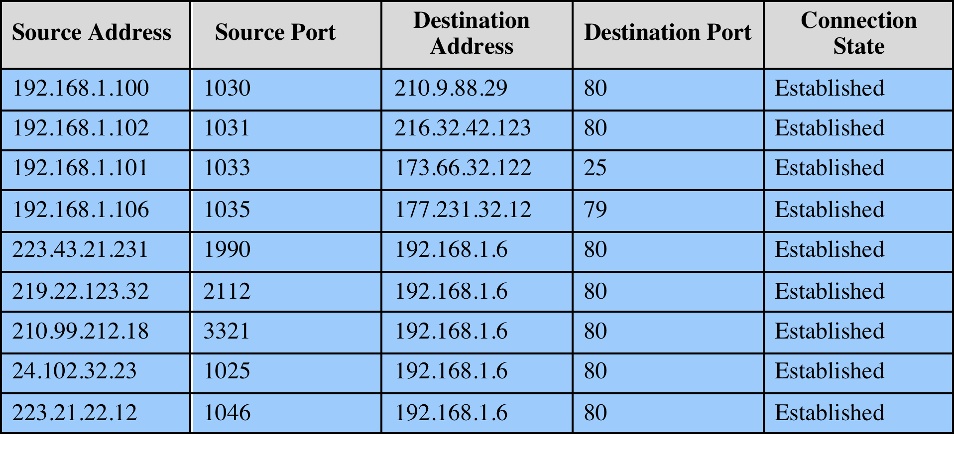
Table 9.2 Example Stateful Firewall
Connection State Table
Some stateful firewalls also keep track of TCP sequence numbers.
Notes:
A stateful inspection packet firewall tightens up the rules for TCP traffic by
creating a directory of outbound TCP connections, as shown in Table 9.2 . There is
an entry for each currently established connection. The packet filter will now allow
incoming traffic to high-numbered ports only for those packets that fit the profile of
one of the entries in this directory.
A stateful packet inspection firewall reviews the same packet information
as a packet filtering firewall, but also records information about TCP connections
(Figure 9.1c). Some stateful firewalls also keep track of TCP sequence numbers
to prevent attacks that depend on the sequence number, such as session hijacking.
Some even inspect limited amounts of application data for some well-known
protocols like FTP, IM, and SIPS commands, in order to identify and track related
connections.

Slide 18
Application-Level Gateway
Also called an application proxy. Acts as a relay of application-level traffic
  User contacts the gateway using a TCP/IP application, such as Telnet or FTP
  Gateway asks the user for the name of the remote host to be accessed.
  User responds and provides a valid user ID and authentication information.
  Gateway contacts the application on the remote host and relays TCP segments containing the application data between the two endpoints.
Tend to be more secure than packet filters
  Rather than trying to deal with the numerous possible combinations that are to be allowed and forbidden at the TCP and IP level, the application-level gateway need only scrutinize a few allowed applications.
Disadvantage is the additional processing overhead on each connection
  Needs to remove original TCP/IP headers and add its own headers before relay.
Notes:
An application-level gateway, also called an application proxy , acts as a relay of
application-level traffic ( Figure 9.1d ). The user contacts the gateway using a TCP/
IP application, such as Telnet or FTP, and the gateway asks the user for the name
of the remote host to be accessed. When the user responds and provides a valid
user ID and authentication information, the gateway contacts the application on
the remote host and relays TCP segments containing the application data between
the two endpoints. If the gateway does not implement the proxy code for a specific
application, the service is not supported and cannot be forwarded across the firewall.
Further, the gateway can be configured to support only specific features of an
application that the network administrator considers acceptable while denying all
other features.
Application-level gateways tend to be more secure than packet filters. Rather
than trying to deal with the numerous possible combinations that are to be allowed
and forbidden at the TCP and IP level, the application-level gateway need only
scrutinize a few allowable applications. In addition, it is easy to log and audit all
incoming traffic at the application level.
A prime disadvantage of this type of gateway is the additional processing
overhead on each connection. In effect, there are two spliced connections between
the end users, with the gateway at the splice point, and the gateway must examine
and forward all traffic in both directions.

Slide 19
Outline
Introduction
Types of firewalls
  Packet filtering firewall
  Stateful inspection firewalls
  Application-level gateway
Firewall basing
  Bastion host
  Host-based firewalls
  Personal firewall
Firewall location and configurations
  DMZ networks
  VPNs
  Distributed firewalls
Intrusion prevention systems
  Host-based IPS
  Network-based IPS
  Snort inline
Unified Threat Management Products

Slide 20
Bastion Host
Standalone system identified as a critical strong point in the network’s security; it serves as a platform for application-level gateways, or to support other services such as IPSec.
Common characteristics:
  Runs secure OS, only essential services, e.g., proxy applications for DNS, FTP, HTTP, and SMTP
  Each proxy can restrict features, hosts accessed
  Each proxy is small, simple, checked for security flaws
  Each proxy is independent, non-privileged
  A proxy generally performs no disk access other than to read its initial configuration file. Hence, the portions of the file system containing executable code can be read only. This makes it difficult for an intruder to install Trojan horse sniffers or other dangerous files on the bastion host.
Notes:
Limited disk use, hence read-only code
A bastion host is a system identified by the firewall administrator as a critical strong
point in the network’s security. Typically, the bastion host serves as a platform for
an application-level or circuit-level gateway. Common characteristics of a bastion
host are as follows:
• The bastion host hardware platform executes a secure version of its operating
system, making it a hardened system.
• Only the services that the network administrator considers essential are
installed on the bastion host. These could include proxy applications for DNS,
FTP, HTTP, and SMTP.
• The bastion host may require additional authentication before a user is allowed
access to the proxy services. In addition, each proxy service may require its
own authentication before granting user access.
• Each proxy is configured to support only a subset of the standard application’s
command set.
• Each proxy is configured to allow access only to specific host systems. This
means that the limited command/feature set may be applied only to a subset
of systems on the protected network.
• Each proxy maintains detailed audit information by logging all traffic, each
connection, and the duration of each connection. The audit log is an essential
tool for discovering and terminating intruder attacks.
• Each proxy module is a very small software package specifically designed for network
security. Because of its relative simplicity, it is easier to check such modules
for security flaws. For example, a typical UNIX mail application may contain
over 20,000 lines of code, while a mail proxy may contain fewer than 1000.
• Each proxy is independent of other proxies on the bastion host. If there is a
problem with the operation of any proxy, or if a future vulnerability is discovered,
it can be uninstalled without affecting the operation of the other proxy
applications. Also, if the user population requires support for a new service, the
network administrator can easily install the required proxy on the bastion host.
• A proxy generally performs no disk access other than to read its initial configuration
file. Hence, the portions of the file system containing executable code
can be made read only. This makes it difficult for an intruder to install Trojan
horse sniffers or other dangerous files on the bastion host.
• Each proxy runs as a non-privileged user in a private and secured directory on
the bastion host.

Slide 21
Host-Based Firewall
Software module used to secure an individual host, typically a server
  In contrast to network firewalls at the network perimeter
Filter and restrict packet flows
Advantages:
  Filtering rules can be tailored to the host environment
  Protection is provided independent of network topology
  Provides an additional layer of protection
Notes:
A host-based firewall is a software module used to secure an individual host. Such
modules are available in many operating systems or can be provided as an add-on
package. Like conventional stand-alone firewalls, host-resident firewalls filter and
restrict the flow of packets. A common location for such firewalls is a server. There
are several advantages to the use of a server-based or workstation-based firewall:
• Filtering rules can be tailored to the host environment. Specific corporate
security policies for servers can be implemented, with different filters for
servers used for different application.
• Protection is provided independent of topology. Thus both internal and external
attacks must pass through the firewall.
• Used in conjunction with stand-alone firewalls, the host-based firewall
provides an additional layer of protection. A new type of server can be added
to the network, with its own firewall, without the necessity of altering the
network firewall configuration.

Slide 22
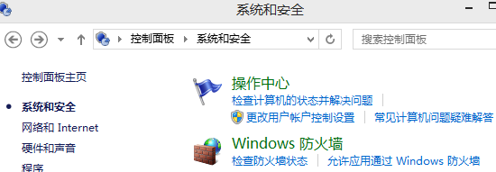
Personal Firewall
Controls traffic between a personal computer or workstation and the Internet or enterprise network
For both home or corporate use
Typically is a software module on a personal computer
Can be housed in a router that connects all of the home computers to a DSL, cable modem, or other Internet interface
Typically much less complex than server-based or stand-alone (bastion host) firewalls
Primary role is to deny unauthorized remote access
May also monitor outgoing traffic to detect and block worms and malware activity
Notes:
A personal firewall controls the traffic between a personal computer or workstation
on one side and the Internet or enterprise network on the other side. Personal firewall
functionality can be used in the home environment and on corporate intranets.
Typically, the personal firewall is a software module on the personal computer. In
a home environment with multiple computers connected to the Internet, firewall
functionality can also be housed in a router that connects all of the home computers
to a DSL, cable modem, or other Internet interface.
Personal firewalls are typically much less complex than either server-based
firewalls or stand-alone firewalls. The primary role of the personal firewall is to
deny unauthorized remote access to the computer. The firewall can also monitor
outgoing activity in an attempt to detect and block worms and other malware.
Personal firewall capabilities are provided by the netfilter package on Linux
systems, or the pf package on BSD and Mac OS X systems. These packages may be
configured on the command-line, or with a GUI front-end. When such a personal
firewall is enabled, all inbound connections are usually denied except for those
the user explicitly permits. Outbound connections are usually allowed. The list of
inbound services that can be selectively re-enabled, with their port numbers, may
include the following common services:
• Personal file sharing (548, 427)
• Windows sharing (139)
• Personal Web sharing (80, 427)
• Remote login—SSH (22)
• FTP access (20-21, 1024-65535 from 20-21)
• Remote Apple events (3031)
• Printer sharing (631, 515)
• IChat Rendezvous (5297, 5298)
• ITunes Music Sharing (3869)
CVS (2401)
• Gnutella/Limewire (6346)
• ICQ (4000)
• IRC (194)
• MSN Messenger (6891-6900)
• Network Time (123)
• Retrospect (497)
• SMB (without netbios–445)
• VNC (5900-5902)
• WebSTAR Admin (1080, 1443)
When FTP access is enabled, ports 20 and 21 on the local machine are opened
for FTP; if others connect to this computer from ports 20 or 21, the ports 1024
through 65535 are open.
For increased protection, advanced firewall features may be configured. For
example, stealth mode hides the system on the Internet by dropping unsolicited
communication packets, making it appear as though the system is not present.
UDP packets can be blocked, restricting network traffic to TCP packets only for
open ports. The firewall also supports logging, an important tool for checking on
unwanted activity. Other types of personal firewall allow the user to specify that
only selected applications, or applications signed by a valid certificate authority,
may provide services accessed from the network.

Slide 23
Outline
Introduction
Types of firewalls
  Packet filtering firewall
  Stateful inspection firewalls
  Application-level gateway
Firewall basing
  Bastion host
  Host-based firewalls
  Personal firewall
Firewall location and configurations
  DMZ networks
  VPNs
  Distributed firewalls
Intrusion prevention systems
  Host-based IPS
  Network-based IPS
  Snort inline
Unified Threat Management Products

Slide 24
Example Firewall Configuration
DMZ (DeMilitarized Zone) (also called perimeter network) is a subnetwork that contains an organization's external-facing services, web, email, DNS servers.
Notes:
Figure 9.2 illustrates a common firewall configuration that includes an additional
network segment between an internal and an external firewall (see also Figure 8.5).
An external firewall is placed at the edge of a local or enterprise network, just
inside the boundary router that connects to the Internet or some wide area network
(WAN). One or more internal firewalls protect the bulk of the enterprise network.
Between these two types of firewalls are one or more networked devices in a
region referred to as a DMZ (demilitarized zone) network. Systems that are externally
accessible but need some protections are usually located on DMZ networks.
Typically, the systems in the DMZ require or foster external connectivity, such as a
corporate Web site, an e-mail server, or a DNS (domain name system) server.

Slide 25
External & Internal Firewalls
The external firewall provides a measure of access control and protection for the DMZ systems consistent with their need for external connectivity, and provides a basic level of protection for the remainder of the enterprise network.
  One example is the firewall for SMTP traffic.
Internal firewalls serve 3 purposes:
  1. Have more stringent filtering rules in order to protect enterprise servers and workstations from external attack.
  2. Provides two-way protection with respect to the DMZ. First, it protects the remainder of the network from attacks launched from DMZ systems. Such attacks might originate from worms, rootkits, bots, or other malware lodged in a DMZ system. Second, it protects the DMZ systems from attack from the internal protected network.
  3. Multiple internal firewalls can be used to partition and protect portions of the internal network from each other.
Notes:
The external firewall provides a measure of access control and protection for
the DMZ systems consistent with their need for external connectivity. The external
firewall also provides a basic level of protection for the remainder of the enterprise
network. In this type of configuration, internal firewalls serve three purposes:
1. The internal firewall adds more stringent filtering capability, compared to the
external firewall, in order to protect enterprise servers and workstations from
external attack.
2. The internal firewall provides two-way protection with respect to the DMZ.
First, the internal firewall protects the remainder of the network from attacks
launched from DMZ systems. Such attacks might originate from worms, rootkits,
bots, or other malware lodged in a DMZ system. Second, an internal firewall can
protect the DMZ systems from attack from the internal protected network.
3. Multiple internal firewalls can be used to protect portions of the internal
network from each other. Figure 8.5 (network intrusion detection system)
shows a configuration in which the internal servers are protected from internal
workstations and vice versa. It also illustrates the common practice of placing
the DMZ on a different network interface on the external firewall from that
used to access the internal networks.

Slide 26
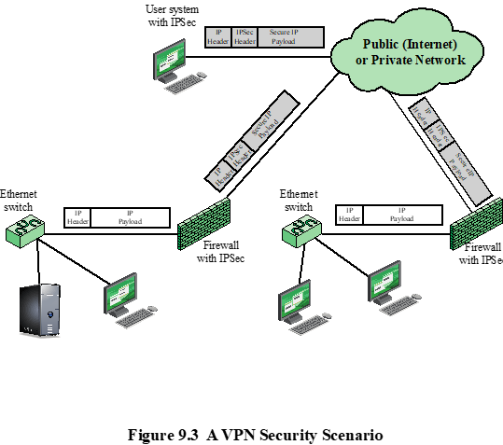
VPN
A Virtual Private Network (VPN) consists of a set of LANs interconnect by the public internet.
Notes:
In today’s distributed computing environment, the virtual private network (VPN)
offers an attractive solution to network managers. In essence, a VPN consists of
a set of computers that interconnect by means of a relatively unsecure network
and that make use of encryption and special protocols to provide security. At each
corporate site, workstations, servers, and databases are linked by one or more local
area networks (LANs). The Internet or some other public network can be used to
interconnect sites, providing a cost savings over the use of a private network and
offloading the wide area network management task to the public network provider.
That same public network provides an access path for telecommuters and other
mobile employees to log on to corporate systems from remote sites.
But the manager faces a fundamental requirement: security. Use of a public
network exposes corporate traffic to eavesdropping and provides an entry point for
unauthorized users. To counter this problem, a VPN is needed. In essence, a VPN
uses encryption and authentication in the lower protocol layers to provide a secure
connection through an otherwise insecure network, typically the Internet. VPNs are
generally cheaper than real private networks using private lines but rely on having
the same encryption and authentication system at both ends. The encryption may
be performed by firewall software or possibly by routers. The most common protocol
mechanism used for this purpose is at the IP level and is known as IPSec.
Figure 9.3 is a typical scenario of IPSec usage. An organization maintains
LANs at dispersed locations. Nonsecure IP traffic is used on each LAN. For traffic
off site, through some sort of private or public WAN, IPSec protocols are used.
These protocols operate in networking devices, such as a router or firewall, that
connect each LAN to the outside world. The IPSec networking device will typically
encrypt and compress all traffic going into the WAN and decrypt and uncompress
traffic coming from the WAN; authentication may also be provided. These operations
are transparent to workstations and servers on the LAN. Secure transmission
is also possible with individual users who dial into the WAN. Such user workstations
must implement the IPSec protocols to provide security. They must also
implement high levels of host security, as they are directly connected to the wider
Internet. This makes them an attractive target for attackers attempting to access
the corporate network.
A logical means of implementing an IPSec is in a firewall, as shown in
Figure 9.3. If IPSec is implemented in a separate box behind (internal to) the firewall,
then VPN traffic passing through the firewall in both directions is encrypted.
In this case, the firewall is unable to perform its filtering function or other security
functions, such as access control, logging, or scanning for viruses. IPSec could be
implemented in the boundary router, outside the firewall. However, this device is
likely to be less secure than the firewall and thus less desirable as an IPSec platform.

Slide 27
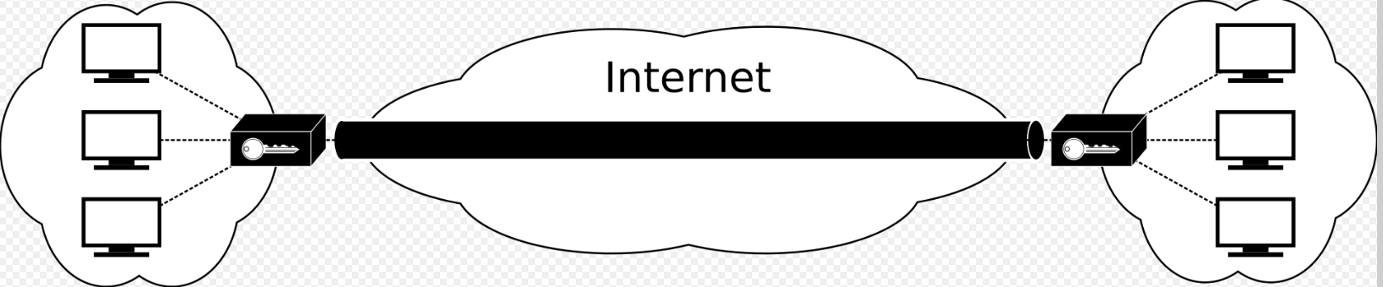
VPN and IPSec
IPSec has 2 modes:
  Transport mode: only the payload of the IP packet is usually encrypted or authenticated.
  Tunnel mode (for VPN): the entire IP packet is encrypted and authenticated. It is then encapsulated into a new IP packet with a new IP header.
IPSec (tunnel mode) should be implemented within the firewall.
  If IPSec is implemented in a separate box different from the firewall, then VPN traffic passing through the firewall in both directions is encrypted, so the firewall is unable to perform filtering or other security functions, such as access control, logging, or scanning for viruses.
Firewall
Firewall
IPSec tunnel mode

Slide 28
Distributed Configuration
A distributed firewall configuration involves stand-alone firewall devices plus host-based firewalls working together under a central administrative control
There may be both an internal DMZ and an external DMZ. Web servers with less critical information on them can be placed in an external DMZ, outside the external firewall.
28
Notes:
A distributed firewall configuration involves stand-alone firewall devices plus host-based
firewalls working together under a central administrative control. Figure 9.4
suggests a distributed firewall configuration. Administrators can configure host
resident firewalls on hundreds of servers and workstation as well as configure
personal firewalls on local and remote user systems. Tools let the network administrator
set policies and monitor security across the entire network. These firewalls
protect against internal attacks and provide protection tailored to specific machines
and applications. Stand-alone firewalls provide global protection, including internal
firewalls and an external firewall, as discussed previously.
With distributed firewalls, it may make sense to establish both an internal
and an external DMZ. Web servers that need less protection because they have
less critical information on them could be placed in an external DMZ, outside the
external firewall. What protection is needed is provided by host-based firewalls on
these servers.
An important aspect of a distributed firewall configuration is security
monitoring. Such monitoring typically includes log aggregation and analysis, firewall
statistics, and fine-grained remote monitoring of individual hosts if needed.

Slide 29
Outline
Introduction
Types of firewalls
  Packet filtering firewall
  Stateful inspection firewalls
  Application-level gateway
Firewall basing
  Bastion host
  Host-based firewalls
  Personal firewall
Firewall location and configurations
  DMZ networks
  VPNs
  Distributed firewalls
Intrusion prevention systems
  Host-based IPS
  Network-based IPS
  Snort inline
Unified Threat Management Products

Slide 30
Intrusion Prevention Systems (IPS)
Also known as Intrusion Detection and Prevention System (IDPS), combining IDS with firewall functionality
Is an extension of an IDS that includes the capability to attempt to block or prevent detected malicious activity
Can be host-based, network-based, or distributed/hybrid
Can block traffic as a firewall does, but makes use of the types of algorithms developed for IDS to determine when to do so
Notes:
A further addition to the range of security products is the intrusion prevention system
(IPS), also known as intrusion detection and prevention system (IDPS). It is
an extension of an IDS that includes the capability to attempt to block or prevent
detected malicious activity. Like an IDS, an IPS can be host-based, network-based,
or distributed/hybrid, as we discuss in Chapter 8. Similarly, it can use anomaly
detection to identify behavior that is not that of legitimate users, or signature/heuristic
detection to identify known malicious behavior.
Once an IDS has detected malicious activity, it can respond by modifying
or blocking network packets across a perimeter or into a host, or by modifying or
blocking system calls by programs running on a host. Thus, a network IPS can block
traffic, as a firewall does, but makes use of the types of algorithms developed for
IDSs to determine when to do so. It is a matter of terminology whether a network
IPS is considered a separate, new type of product or simply another form of firewall.

Slide 31
Host-based IPS (HIPS)
Can make use of either signature/heuristic or anomaly detection techniques to identify attacks
  Signature: look for malicious patterns in the content of application network traffic, or in sequences of system calls, to identify known malicious behavior .
  Anomaly: detect anomalies that deviate from normal behavior
  c.f. L9-CH08-Intrusion Detection p. 10.
Examples types of malicious behavior addressed by HIPS:
  Modification of system resources
  Privilege-escalation exploits (e.g., set-UID)
  Buffer-overflow exploits
  Access to e-mail contact list
  Directory traversal
Notes:
Can use anomaly detection to identify behavior that is not that of legitimate users, or signature/heuristic detection to identify known malicious behavior
A host-based IPS (HIPS) can make use of either signature/heuristic or anomaly
detection techniques to identify attacks. In the former case, the focus is on the specific
content of application network traffic, or of sequences of system calls, looking
for patterns that have been identified as malicious. In the case of anomaly detection,
the IPS is looking for behavior patterns that indicate malware. Examples of the
types of malicious behavior addressed by a HIPS include the following:
• Modification of system resources: Rootkits, Trojan horses, and backdoors
operate by changing system resources, such as libraries, directories, registry
settings, and user accounts.
• Privilege-escalation exploits: These attacks attempt to give ordinary users
root access.
• Buffer-overflow exploits: These attacks are described in Chapter 10 .
• Access to e-mail contact list: Many worms spread by mailing a copy of themselves
to addresses in the local system’s e-mail address book.
• Directory traversal: A directory traversal vulnerability in a Web server allows
the hacker to access files outside the range of what a server application user
would normally need to access.
Attacks such as these result in behaviors that can be analyzed by a HIPS. The
HIPS capability can be tailored to the specific platform. A set of general-purpose
tools may be used for a desktop or server system. Some HIPS packages are designed
to protect specific types of servers, such as Web servers and database servers. In this
case, the HIPS looks for particular application attacks.
In addition to signature and anomaly-detection techniques, a HIPS can use
a sandbox approach. Sandboxes are especially suited to mobile code, such as Java
applets and scripting languages. The HIPS quarantines such code in an isolated
system area, then runs the code and monitors its behavior. If the code violates
predefined policies or matches predefined behavior signatures, it is halted and
prevented from executing in the normal system environment.
[ROBB06a] lists the following as areas for which a HIPS typically offers desktop
protection:
• System calls: The kernel controls access to system resources such as memory,
I/O devices, and processor. To use these resources, user applications invoke
system calls to the kernel. Any exploit code will execute at least one system
call. The HIPS can be configured to examine each system call for malicious
characteristics.
• File system access: The HIPS can ensure that file access system calls are not
malicious and meet established policy.
System registry settings: The registry maintains persistent configuration
information about programs and is often maliciously modified to extend the
life of an exploit. The HIPS can ensure that the system registry maintains its
integrity.
• Host input/output: I/O communications, whether local or network based, can
propagate exploit code and malware. The HIPS can examine and enforce
proper client interaction with the network and its interaction with other
devices.
Many industry observers see the enterprise endpoint,
including desktop and laptop systems, as now the main target for hackers and
criminals, more so than network devices [ROBB06b]. Thus, security vendors are
focusing more on developing endpoint security products. Traditionally, endpoint
security has been provided by a collection of distinct products, such as antivirus,
antispyware, antispam, and personal firewalls. The HIPS approach is an effort to
provide an integrated, single-product suite of functions. The advantages of the
integrated HIPS approach are that the various tools work closely together, threat
prevention is more comprehensive, and management is easier.
It may be tempting to think that endpoint security products such as HIPS,
if sophisticated enough, eliminate or at least reduce the need for network-level
devices. For example, the San Diego Supercomputer Center reports that over a
four-year period, there were no intrusions on any of its managed machines, in a
configuration with no firewalls and just endpoint security protection [SING03].
Nevertheless, a more prudent approach is to use HIPS as one element in a strategy
that involves network-level devices, such as either firewalls or network-based
IPSs.

Slide 32
Protection Areas of HIPS
System calls: The kernel controls access to system resources such as memory, I/O devices, and processor. To use these resources, user applications invoke system calls to the kernel. Any exploit code will execute at least one system call. The HIPS can be configured to examine each system call for malicious characteristics.
  File system access: The HIPS can ensure that file access system calls are not malicious and meet established policy.
System registry settings: The Windows registry maintains persistent configuration information about programs and is often maliciously modified to extend the life of an exploit. The HIPS can ensure that the system registry maintains its integrity.
Host input/output: I/O communications, whether local or network based, can propagate exploit code and malware. The HIPS can examine and enforce proper client interaction with the network and its interaction with other devices.
Notes:
[ROBB06a] lists the following as areas for which a HIPS typically offers desktop
protection:
• System calls: The kernel controls access to system resources such as memory,
I/O devices, and processor. To use these resources, user applications invoke
system calls to the kernel. Any exploit code will execute at least one system
call. The HIPS can be configured to examine each system call for malicious
characteristics.
• File system access: The HIPS can ensure that file access system calls are not
malicious and meet established policy.
System registry settings: The registry maintains persistent configuration
information about programs and is often maliciously modified to extend the
life of an exploit. The HIPS can ensure that the system registry maintains its
integrity.
• Host input/output: I/O communications, whether local or network based, can
propagate exploit code and malware. The HIPS can examine and enforce
proper client interaction with the network and its interaction with other
devices.

Slide 33
The Role of HIPS
Traditionally, endpoint security has been provided by a collection of distinct products, such as antivirus, antispyware, antispam, and personal firewalls
The integrated HIPS approach provides an integrated, single-product suite of functions that work closely together
HIPS may be used as the last line-of-defense in a defense-in-depth strategy, in addition to firewalls and/or network-based IPS
Notes:
Many industry observers see the enterprise endpoint,
including desktop and laptop systems, as now the main target for hackers and
criminals, more so than network devices [ROBB06b]. Thus, security vendors are
focusing more on developing endpoint security products. Traditionally, endpoint
security has been provided by a collection of distinct products, such as antivirus,
antispyware, antispam, and personal firewalls. The HIPS approach is an effort to
provide an integrated, single-product suite of functions. The advantages of the
integrated HIPS approach are that the various tools work closely together, threat
prevention is more comprehensive, and management is easier.
It may be tempting to think that endpoint security products such as HIPS,
if sophisticated enough, eliminate or at least reduce the need for network-level
devices. For example, the San Diego Supercomputer Center reports that over a
four-year period, there were no intrusions on any of its managed machines, in a
configuration with no firewalls and just endpoint security protection [SING03].
Nevertheless, a more prudent approach is to use HIPS as one element in a strategy
that involves network-level devices, such as either firewalls or network-based
IPSs.

Slide 34
Network-Based IPS (NIPS)
Inline NIDS with the authority to modify or discard packets and tear down TCP connections
Makes use of signature/heuristic detection and anomaly detection
Methods used to identify malicious packets:
  Pattern matching: Scans incoming packets for specific byte sequences (signature) stored in a database of known attacks
  Stateful matching: Scans for attack signatures in the context of a traffic stream (TCP connection) rather than individual packets
  Protocol anomaly: Looks for deviation from standards set forth in RFCs
  Traffic anomaly: Watches for unusual traffic activities, such as a flood of UDP packets or a new service appearing on the network
  Statistical anomaly: Develops baselines of normal traffic activity and throughput, and alerts on deviations from those baselines
Notes:
A network-based IPS (NIPS) is in essence an inline NIDS with the authority to
discard packets and tear down TCP connections. As with a NIDS, a NIPS makes use
of techniques such as signature detection and anomaly detection.
Among the techniques used in a NIPS but not commonly found in a firewall
is flow data protection. This requires that the application payload in a sequence
of packets be reassembled. The IPS device applies filters to the full content of the
flow every time a new packet for the flow arrives. When a flow is determined to be
malicious, the latest and all subsequent packets belonging to the suspect flow are
dropped.

Slide 35
Snort Inline
Snort Inline adds three new rule types for intrusion prevention, to enable Snort IDS to function as an IPS.
  Drop
    Packet is rejected and result is logged
  Reject
    Packet is rejected and result is logged, and an error message is returned e.g., TCP connection reset
  Sdrop
    Packet is rejected but not logged
Notes:
We introduced Snort in Chapter 8 as a system.
A modified version of Snort, known as Snort Inline, enhances Snolightweight intrusion detection rt to function
as an intrusion prevention system. Snort Inline adds three new rule types that
provide intrusion prevention features:
• Drop: Snort rejects a packet based on the options defined in the rule and logs
the result.
• Reject: Snort rejects a packet and logs the result. In addition, an error message
is returned. In the case of TCP, this is a TCP reset message, which resets the
TCP connection. In the case of UDP, an ICMP port unreachable message is
sent to the originator of the UDP packet.
• Sdrop: Snort rejects a packet but does not log the packet.
Snort Inline includes a replace option, which allows the Snort user to modify
packets rather than drop them. This feature is useful for a honeypot implementation
[SPIT03]. Instead of blocking detected attacks, the honeypot modifies and
disables them by modifying packet content. Attackers launch their exploits, which
travel the Internet and hit their intended targets, but Snort Inline disables the
attacks, which ultimately fail. The attackers see the failure but can’t figure out why
it occurred. The honeypot can continue to monitor the attackers while reducing the
risk of harming remote systems.

Slide 36
Outline
Introduction
Types of firewalls
  Packet filtering firewall
  Stateful inspection firewalls
  Application-level gateway
Firewall basing
  Bastion host
  Host-based firewalls
  Personal firewall
Firewall location and configurations
  DMZ networks
  VPNs
  Distributed firewalls
Intrusion prevention systems
  Host-based IPS
  Network-based IPS
  Snort inline
Unified Threat Management Products

Slide 37
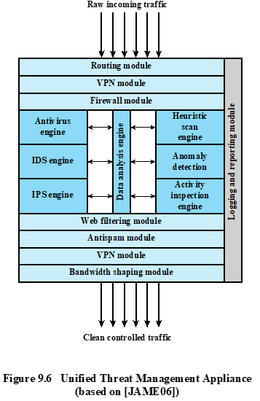
Unified Threat Management (UTM)
One approach to reducing the administrative and performance burden is to replace all inline network products (firewall, IPS, IDS, VPN, antispam, anti-spyware…) with a single device that integrates a variety of approaches to dealing with network-based attacks.
Notes:
In the past few chapters, we have reviewed a number of approaches to countering
malicious software and network-based attacks, including antivirus and antiworm
products, IPS and IDS, and firewalls. The implementation of all of these systems can
provide an organization with a defense in depth using multiple layers of filters and
defense mechanisms to thwart attacks. The downside of such a piecemeal implementation
is the need to configure, deploy, and manage a range of devices and software
packages. In addition, deploying a number of devices in sequence can reduce
performance.
One approach to reducing the administrative and performance burden is to
replace all inline network products (firewall, IPS, IDS, VPN, antispam, antisypware,
and so on) with a single device that integrates a variety of approaches to dealing
with network-based attacks. The market analyst firm IDC refers to such a device as
a unified threat management (UTM) system and defines UTM as follows: “Products
that include multiple security features integrated into one box. To be included in
this category, [an appliance] must be able to perform network firewalling, network
intrusion detection and prevention and gateway anti-virus. All of the capabilities in
the appliance need not be used concurrently, but the functions must exist inherently
in the appliance.”
A significant issue with a UTM device is performance, both throughput and
latency. [MESS06] reports that typical throughput losses for current commercial
devices is 50% Thus, customers are advised to get very high-performance,
high-throughput devices to minimize the apparent performance degradation.
Figure 9.6 is a typical UTM appliance architecture. The following functions
are noteworthy:
1. Inbound traffic is decrypted if necessary before its initial inspection. If the
device functions as a VPN boundary node, then IPSec decryption would take
place here.
An initial firewall module filters traffic, discarding packets that violate rules
and/or passing packets that conform to rules set in the firewall policy.
3. Beyond this point, a number of modules process individual packets and flows
of packets at various protocols levels. In this particular configuration, a data
analysis engine is responsible for keeping track of packet flows and coordinating
the work of antivirus, IDS, and IPS engines.
4. The data analysis engine also reassembles multipacket payloads for content
analysis by the antivirus engine and the Web filtering and antispam modules.
5. Some incoming traffic may need to be reencrypted to maintain security of the
flow within the enterprise network.
6. All detected threats are reported to the logging and reporting module, which
is used to issue alerts for specified conditions and for forensic analysis.
7. The bandwidth-shaping module can use various priority and quality-of-service
(QoS) algorithms to optimize performance.

